Slide 1



LANGUAGE MODELS OPS
An introduction to the fine-tuning and deployment of language models
Maxime Sazadaly

Slide 2



WHY IT MATTERS
Language models are core to most of modern NLP applications at the moment. After their introduction, we have seen performance increases in a wide range of NLP subtasks by a factor of around 5-10%. Given the fact that previous state of the art systems yielded 70%+ scores, this was a huge achievement on par with the introduction of CNNs in computer vision.
Despite being powerful in terms of task handling, they fall short on their size and capacity to be deployed at scale easily. In 2018, BERT (a notably performant Transformer based architecture) was released with 320M trainable parameters. GPT-3.5 (another notably performant language model released in 2021) has 175B parameters (x510 in size). In 2025, we see the release of models with 1T params (e.g. Kimi-K2).
As a result, creating and deploying systems based on those architectures have proven to be difficult. This presentation will highlight some techniques that were introduced to tackle this situation and help us put those systems into production.

Slide 3

SUMMARY
FINETUNING LANGUAGE MODELS
OPTIMIZATIONS
DEPLOYMENT

Slide 4

PART I FINETUNING LANGUAGE MODELS

Slide 5

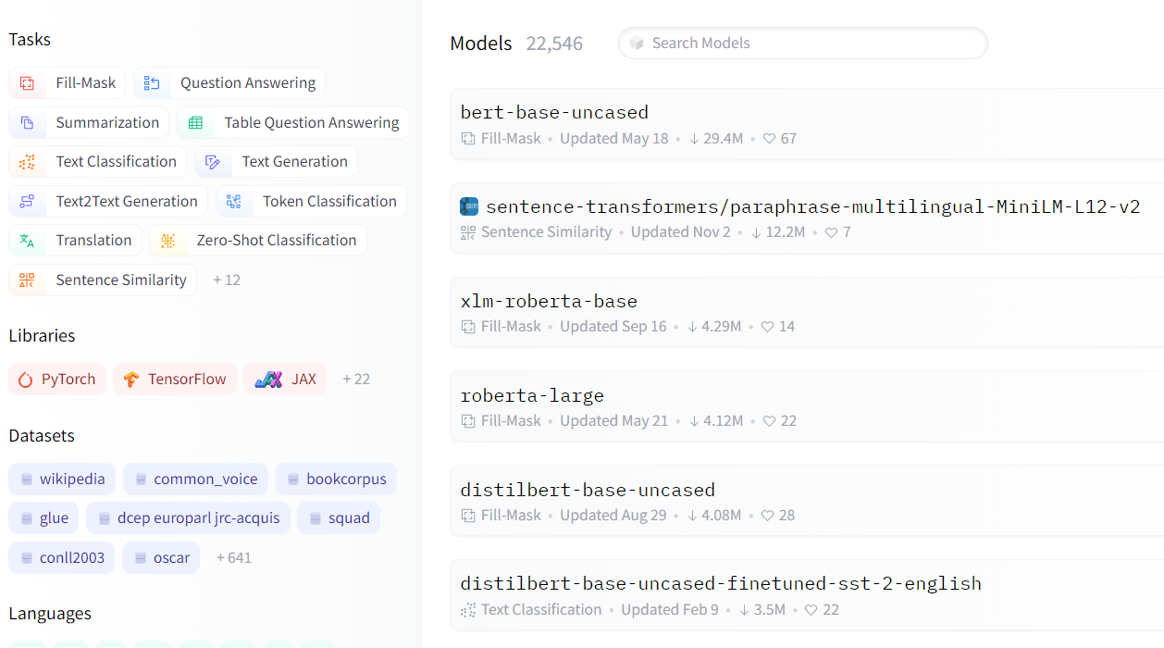

USING PRETRAINED MODELS – AS EASY AS 1,2,3
Currently more than 20K pretrained models available on Huggingface’s model hub
https://huggingface.co/models

Slide 6
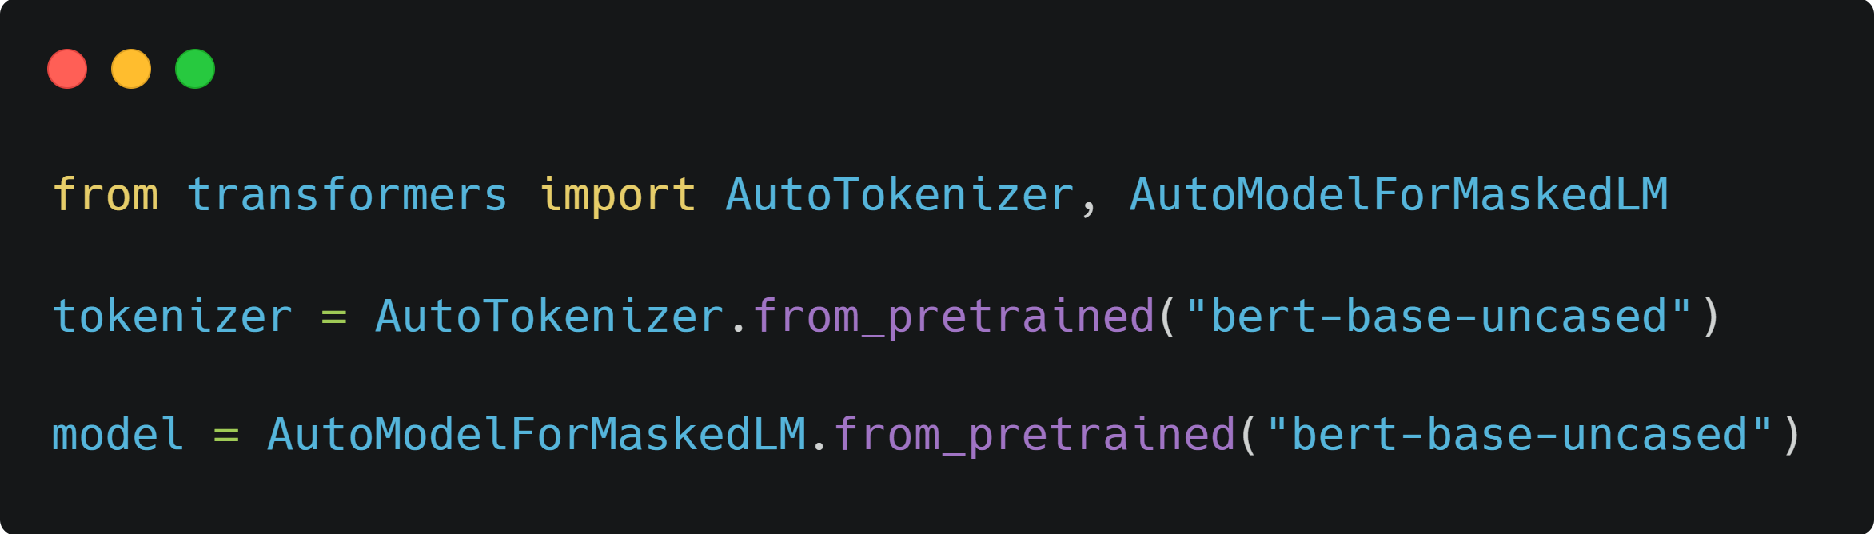
USING PRETRAINED MODELS – AS EASY AS 1,2,3

Slide 7
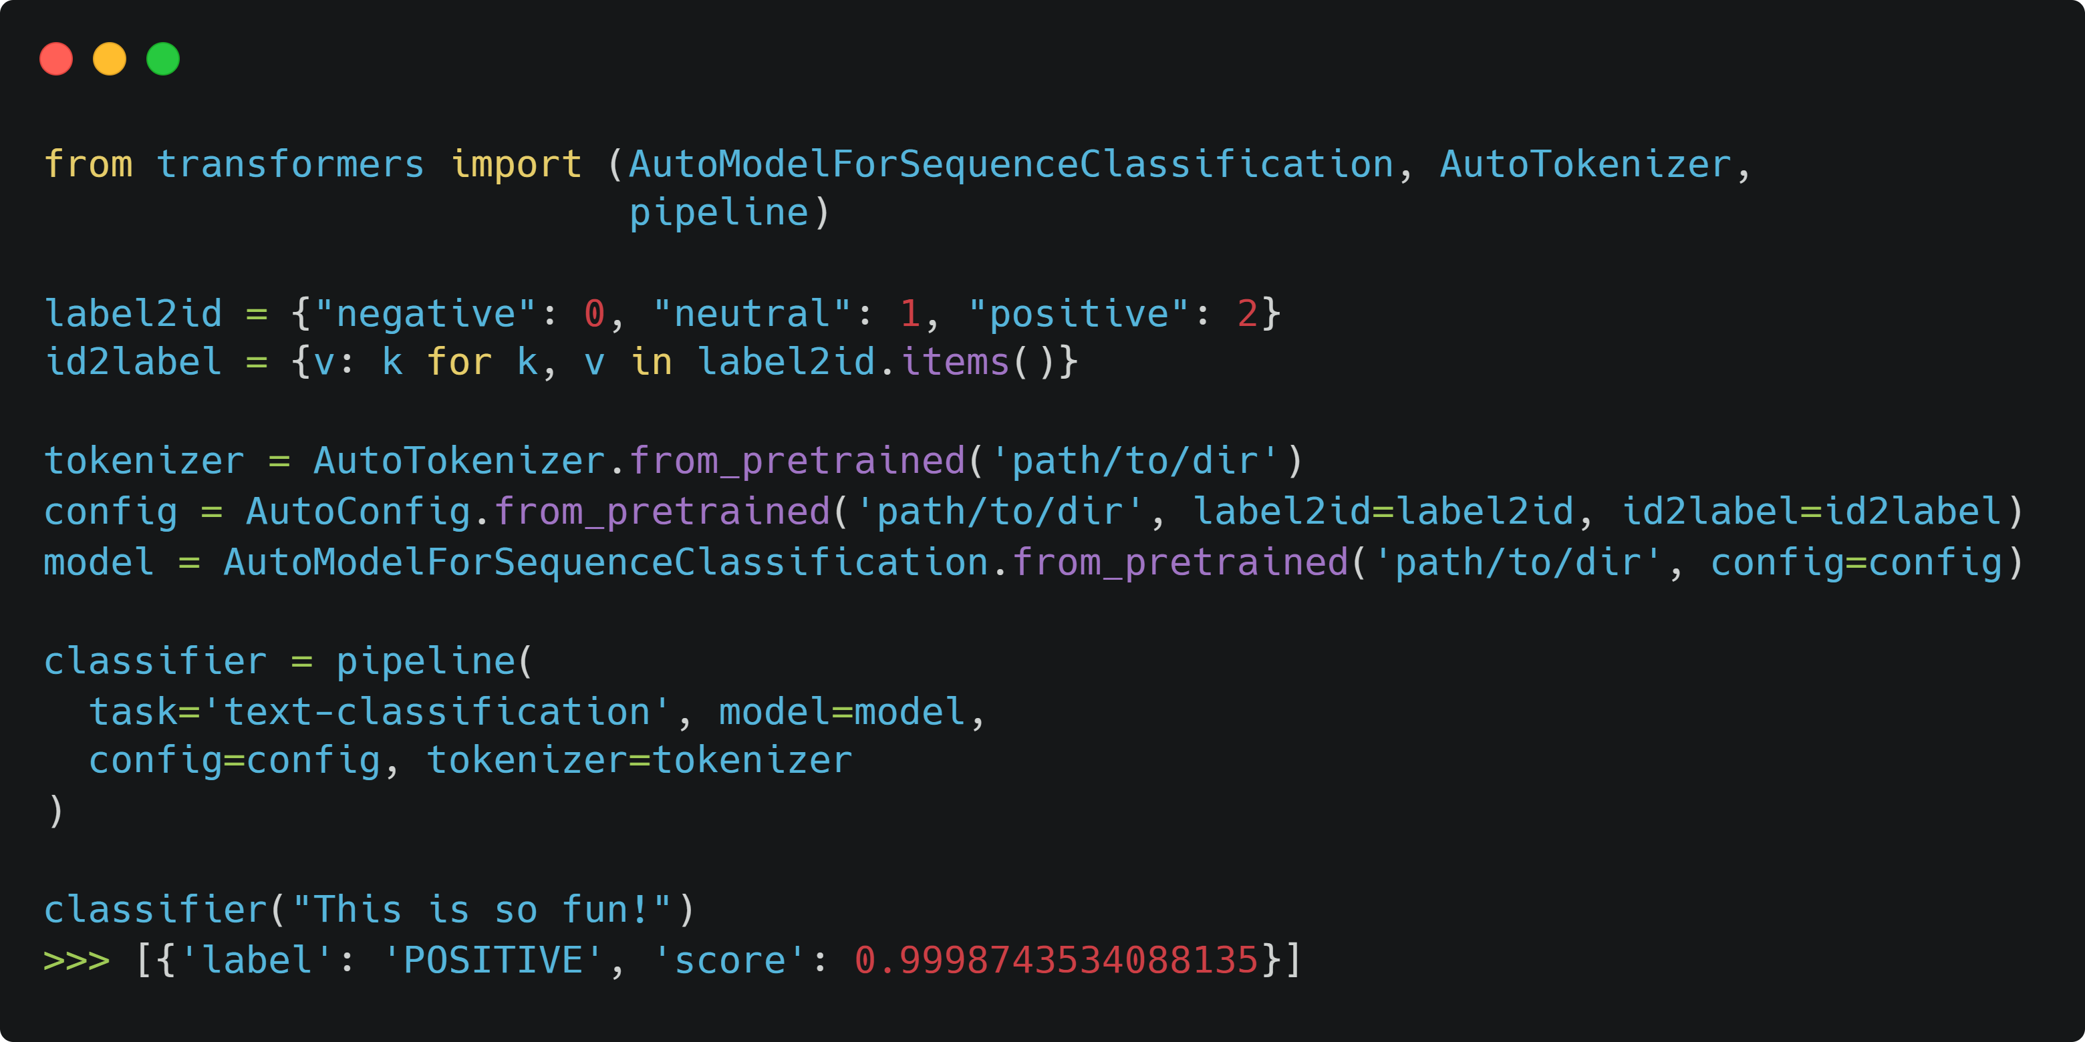


USING A PRETRAINED CLASSIFIER
Similarly, fine tuned models can be loaded in less than 10 lines of code:

Slide 8
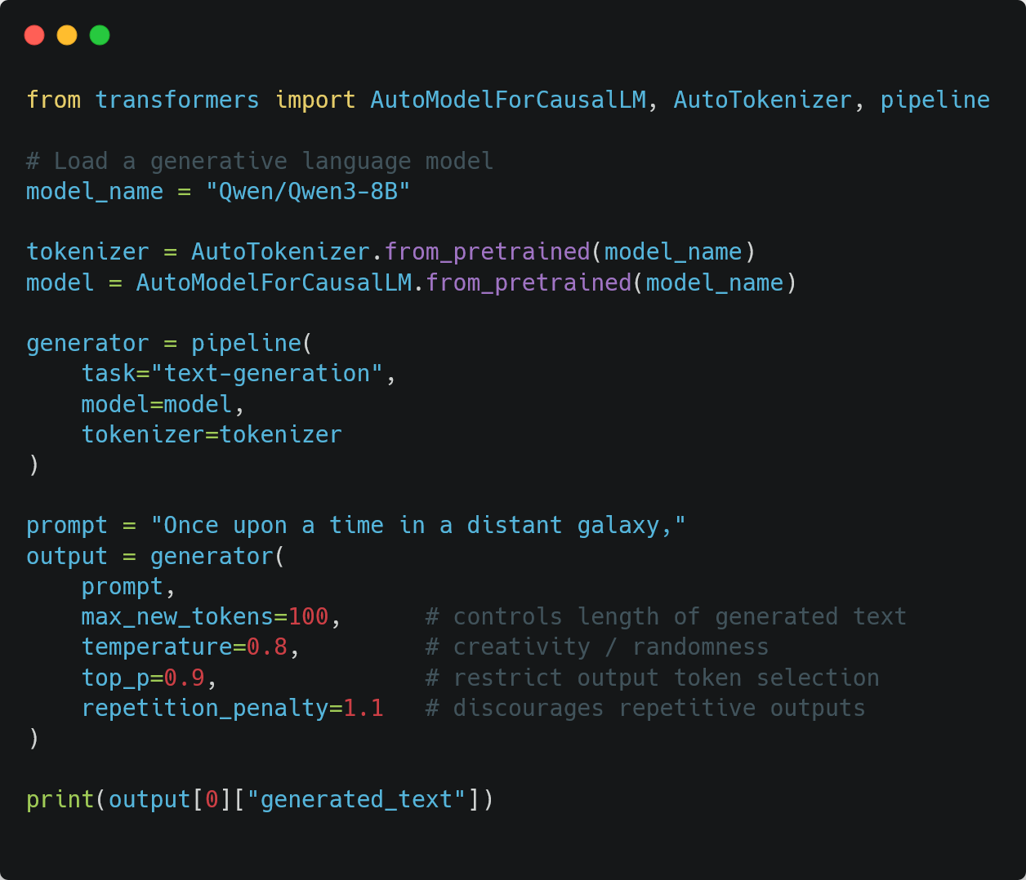
USING A PRETRAINED GENERATIVE MODEL

Slide 9
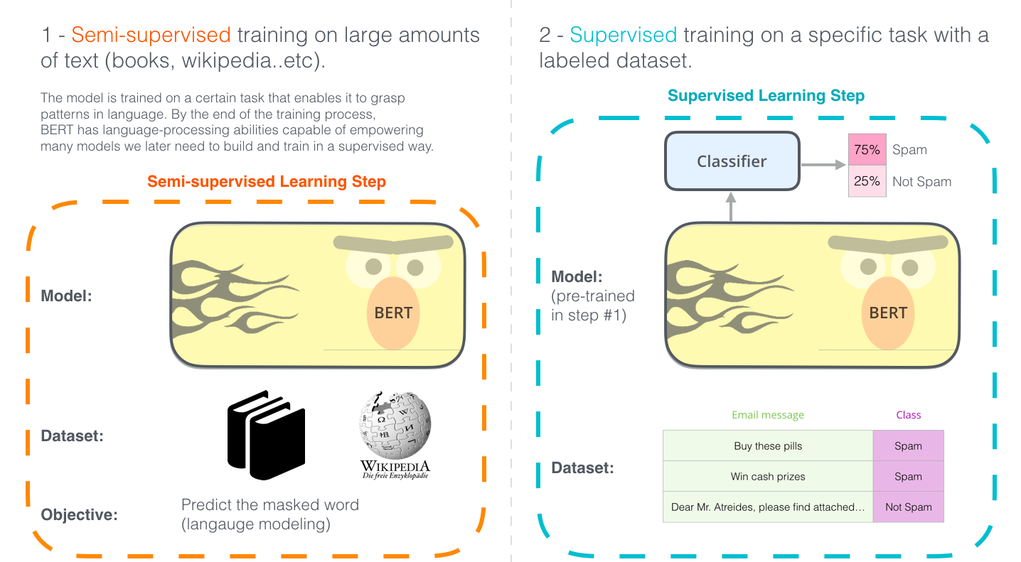
FINETUNING 101
Jay Alammar’s blog

Slide 10
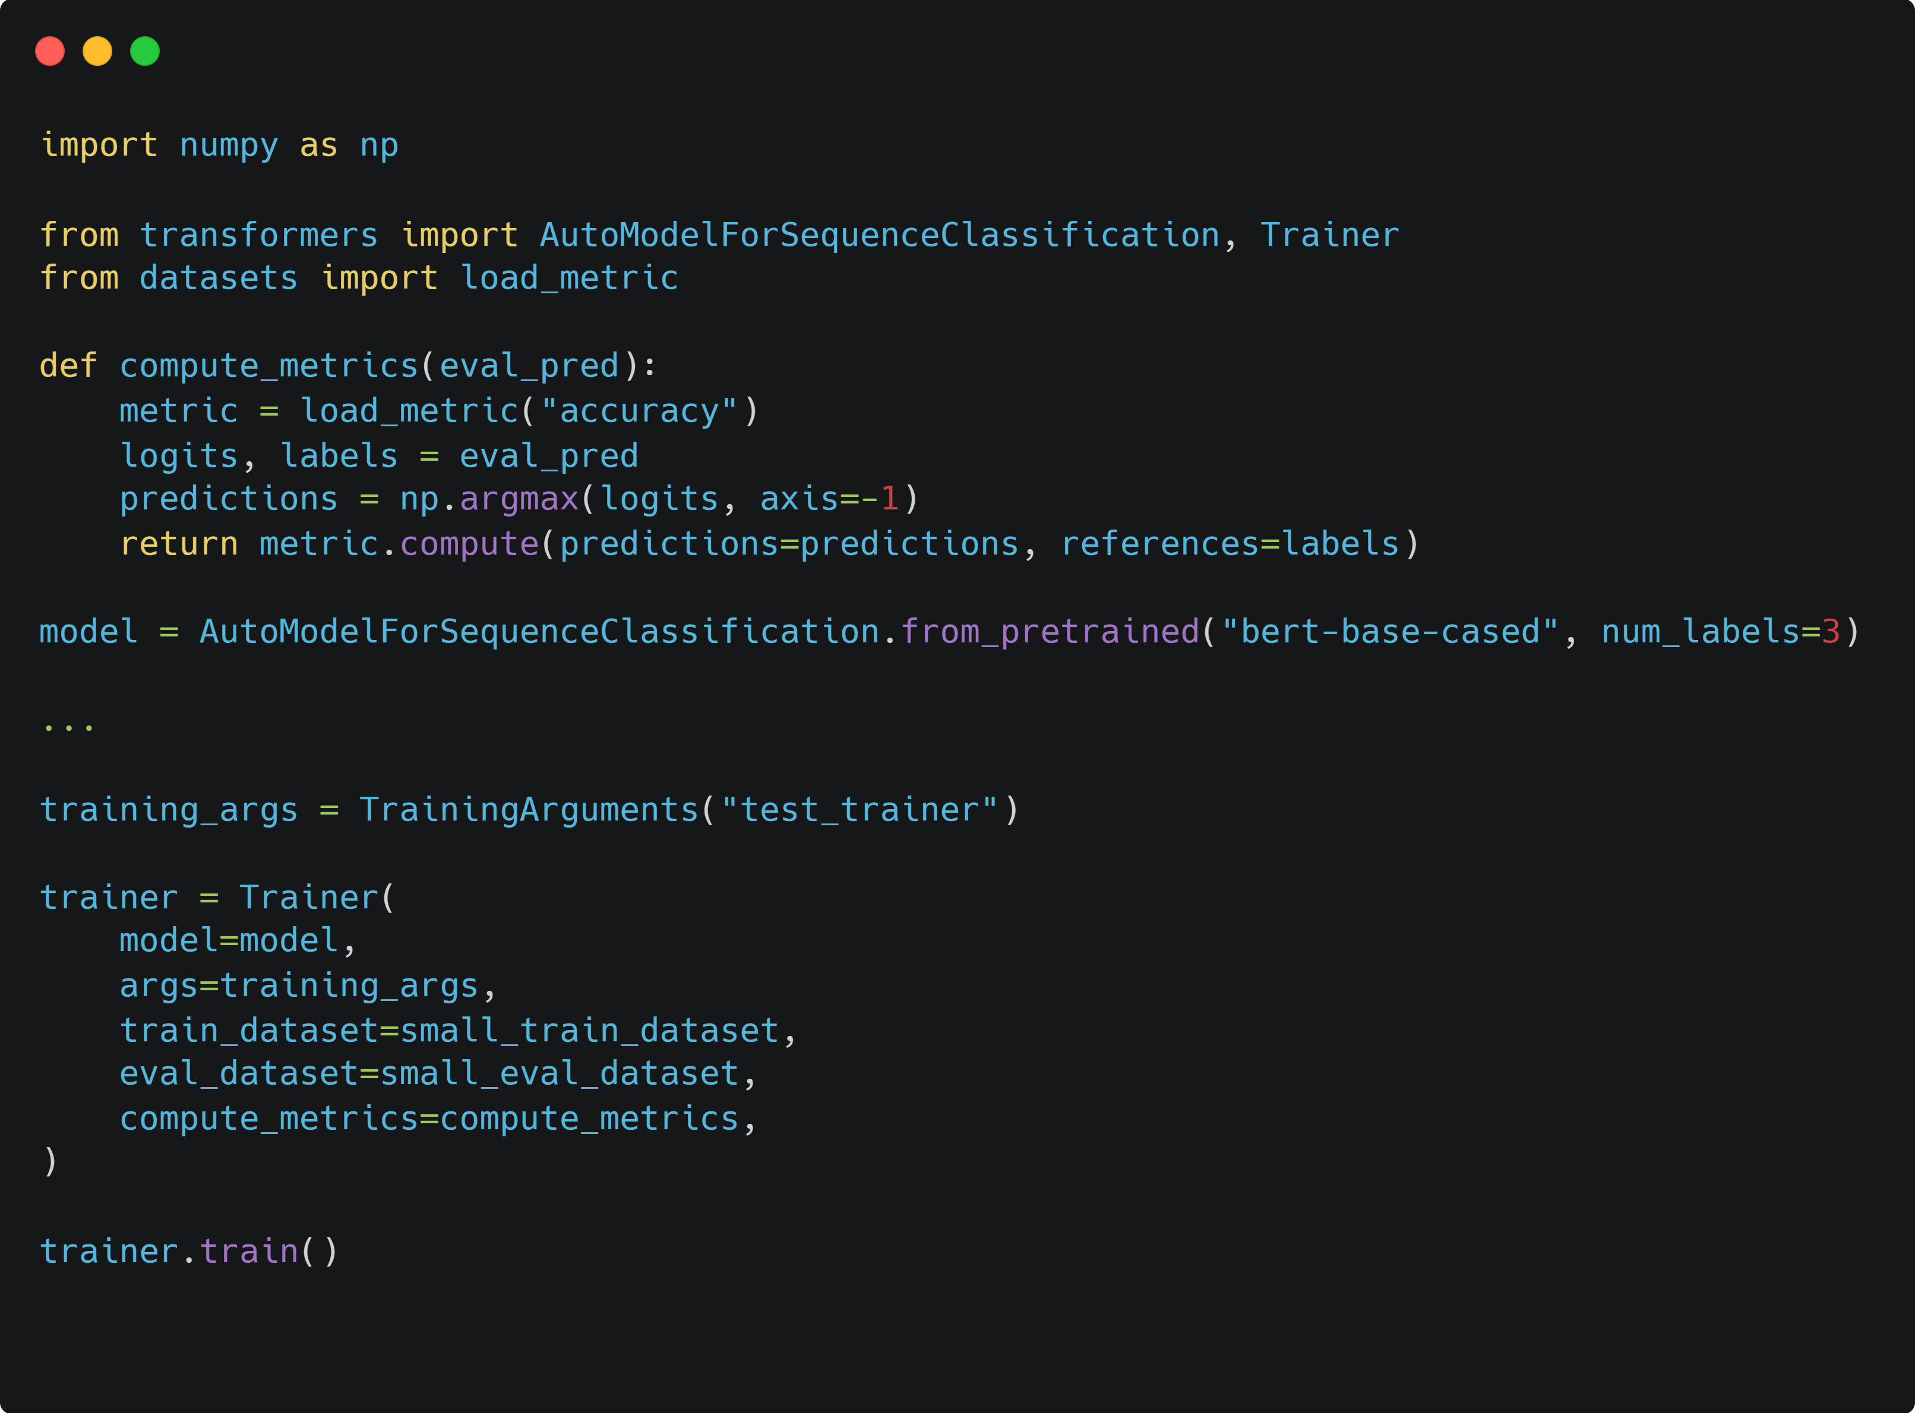
FINETUNING 101
Still easy, right?
Similar interface to sklearn

Slide 11
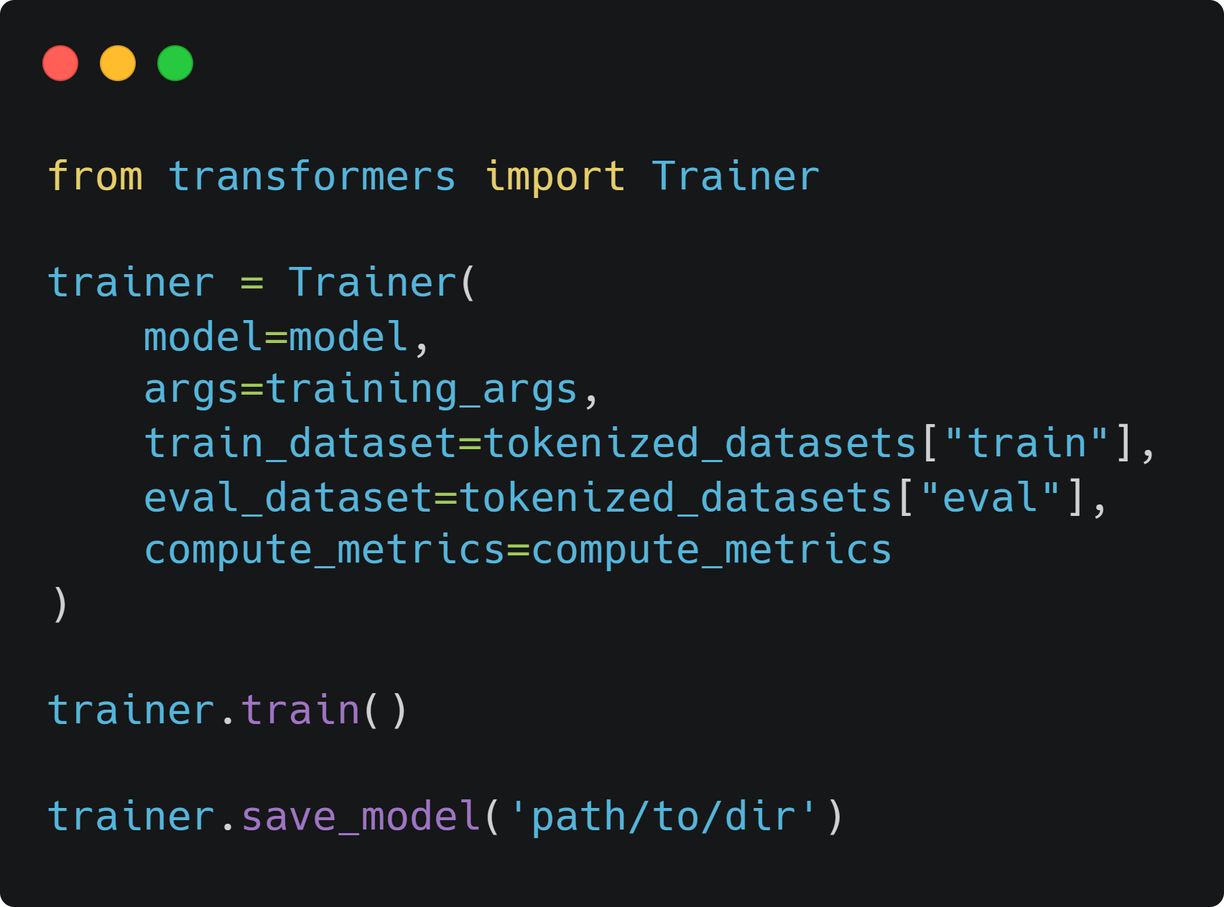
FINETUNING 101
Models can be easily saved using the transformers library:

Slide 12
PART I FINETUNING LANGUAGE MODELS CLASSIFIERS

Slide 13
FINETUNING CLASSIFIERS
Finetuning classifiers has become sort of a commodity nowadays. As for any other ML approaches, the key is now in understanding:
What is the task that needs to be solved
What is the most relevant model / training method
How to evaluate your model performances
What data do you need to conduct your training
Hugging Face LLM course is a great entrypoint to learn how to fine tune classifiers.

Slide 14
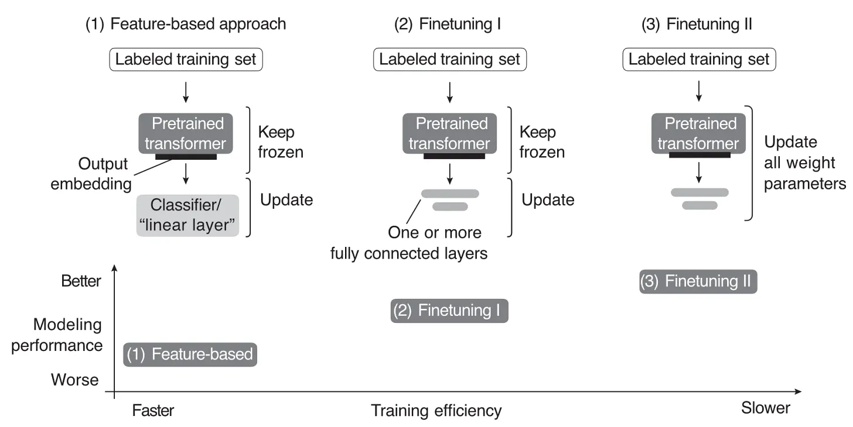
FINETUNING CLASSIFIERS
https://magazine.sebastianraschka.com/p/using-and-finetuning-pretrained-transformers

Slide 15
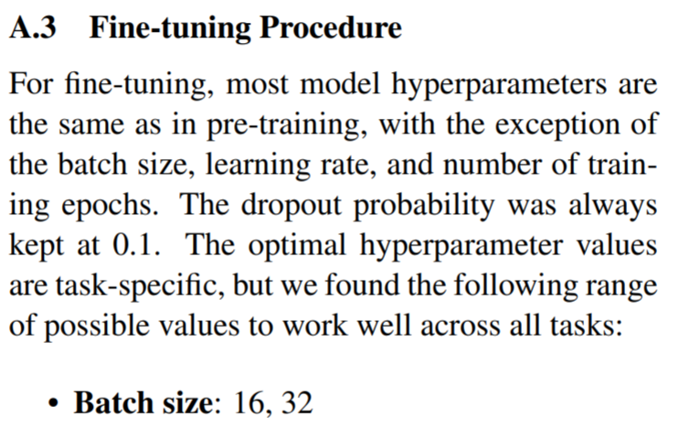
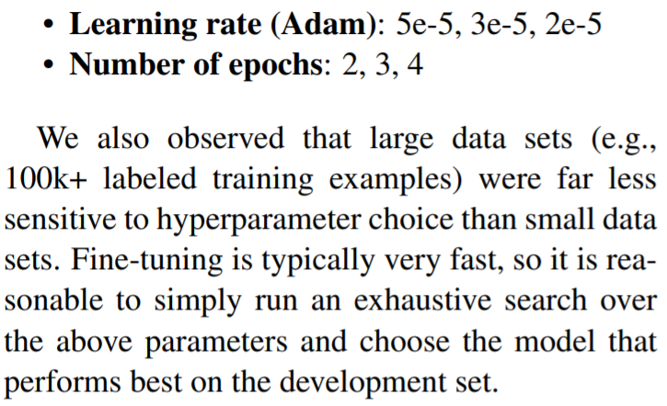
FINETUNING CLASSIFIERS
Initially, fine-tuned language models often went with almost the same hyperparameters as the pretrained version. [BERT paper]
BERT: Pre-training of Deep Bidirectional Transformers for Language Understanding

Slide 16
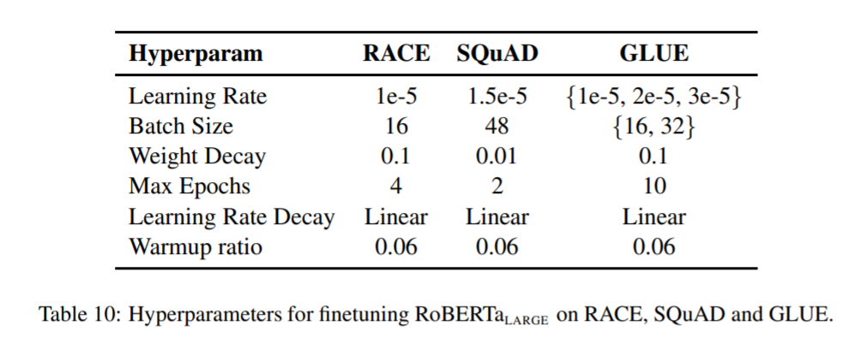
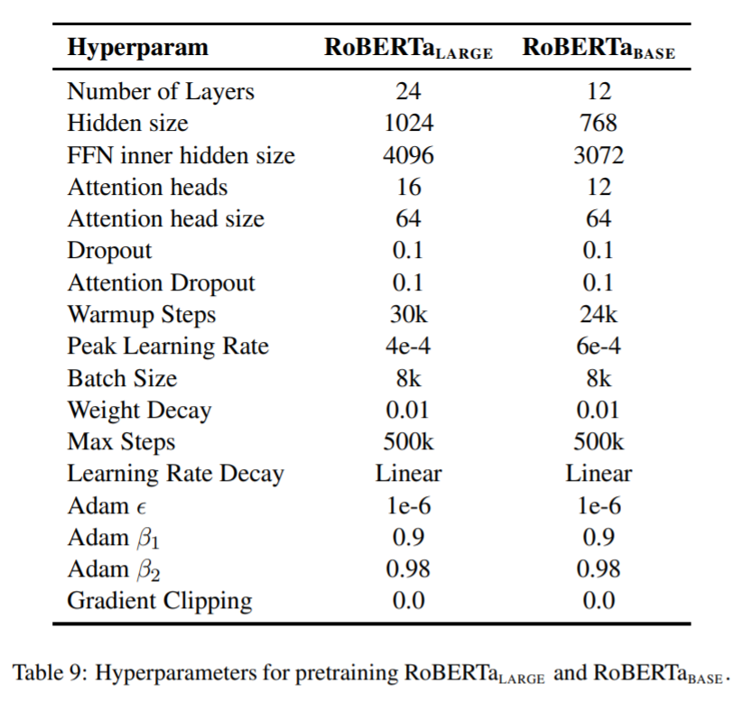
FINETUNING CLASSIFIERS
Initially, fine-tuned language models often went with almost the same hyperparameters as the pretrained version. [BERT paper]
However, this statement was challenged later on: careful hyperparameter selection showed notable performance improvement. [RoBERTa paper]
RoBERTa: A Robustly Optimized BERT Pretraining Approach

Slide 17
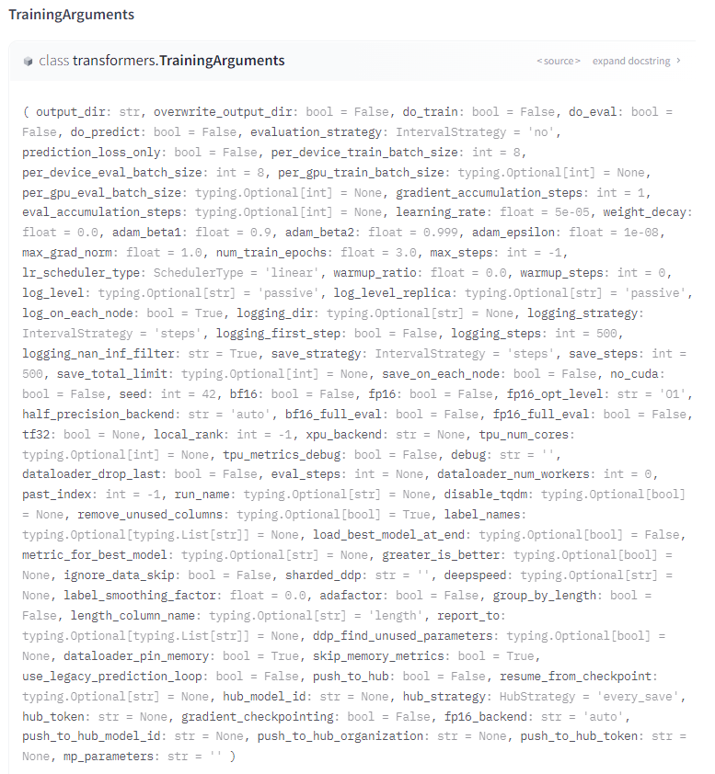
FINETUNING CLASSIFIERS
Initially, fine-tuned language models often went with almost the same hyperparameters as the pretrained version. [BERT paper]
However, this statement was challenged later on: careful hyperparameter selection showed notable performance improvement. [RoBERTa paper]
As such, convergence of such models is tied to the set of hyperparameters used, especially for low amount of data. Hint: there are a lot!

Slide 18
HYPERPARAMETER OPTIMIZATION
How do we identify best hyperparameters when training a model is time consuming and costly?

Slide 19
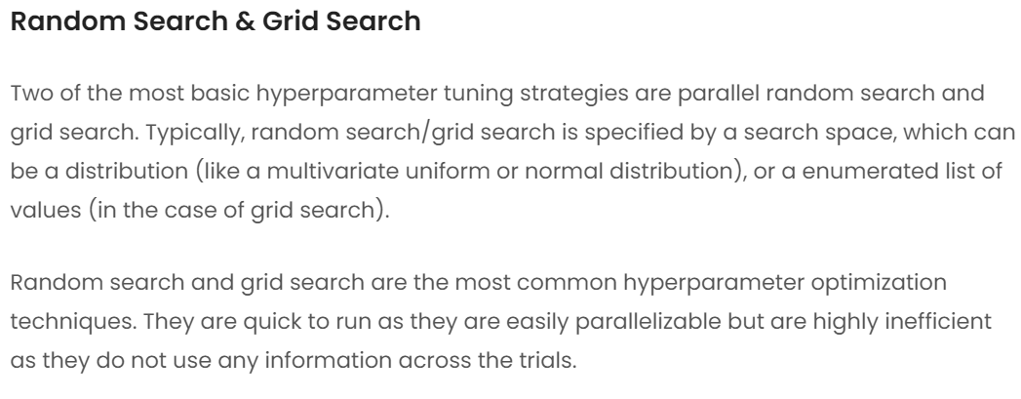
HYPERPARAMETER SELECTION
https://www.anyscale.com/blog/population-based-bandits

Slide 20
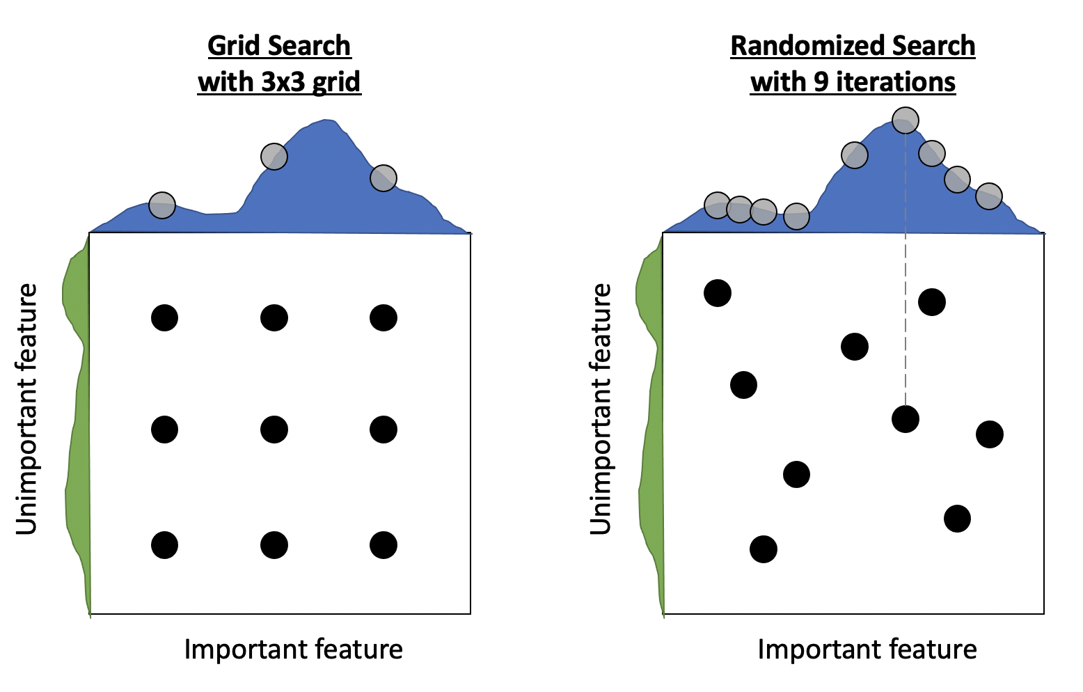
HYPERPARAMETER SELECTION
https://towardsdatascience.com/gridsearch-vs-randomizedsearch-vs-bayesiansearch-cfa76de27c6b

Slide 21
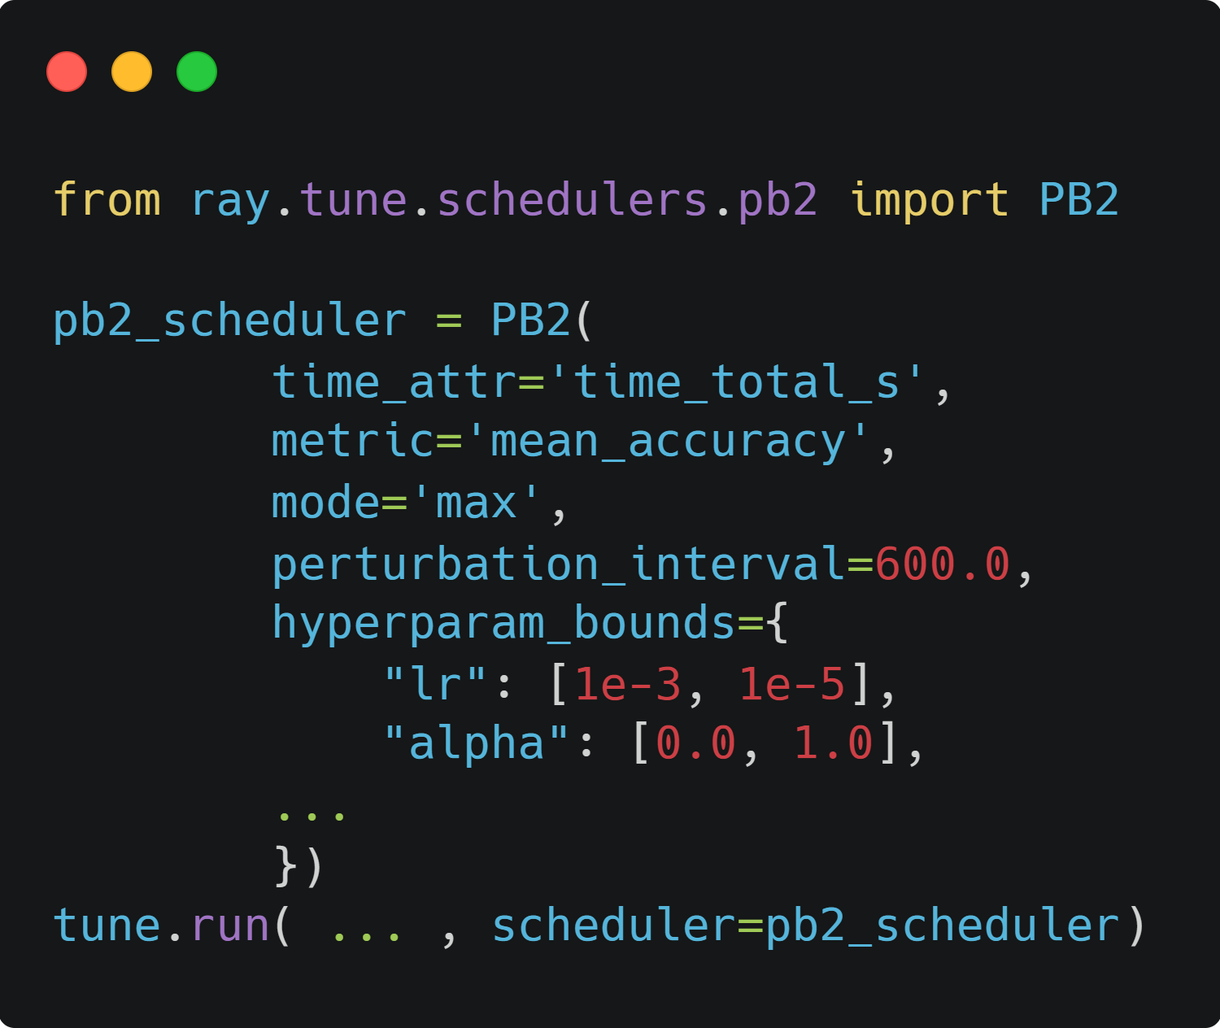

HYPERPARAMETER SELECTION
Tune is a Python library for experiment execution and hyperparameter tuning at any scale. It is included within Ray, another Python library dedicated to the building of distributed applications.

Slide 22
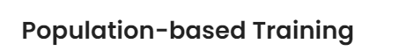
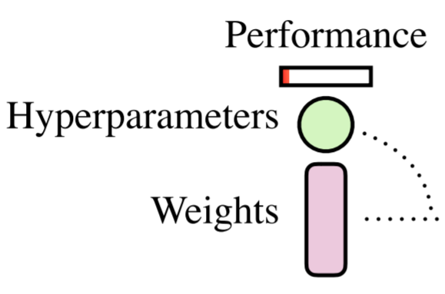
HYPERPARAMETER SELECTION
A single run is composed of three elements:
A hyperparameter set
Trained model weights
Performance of such a model
Population Based Training of Neural Networks

Slide 23
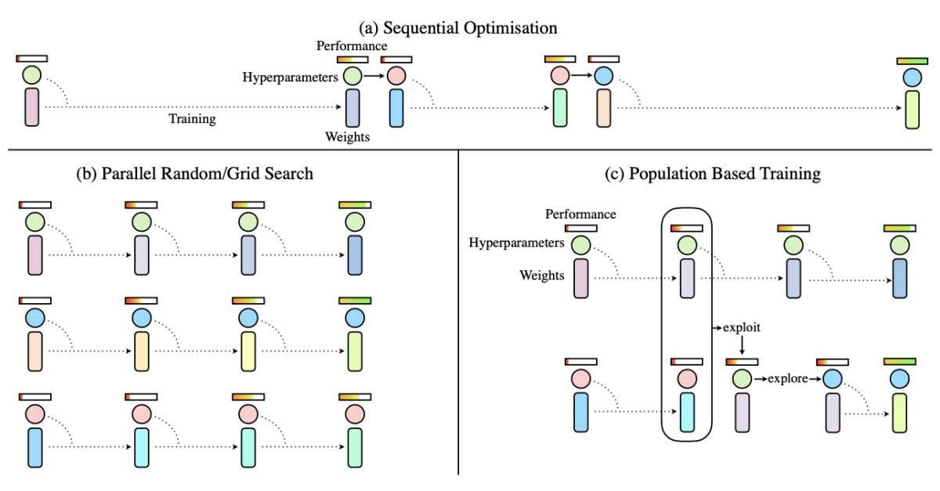
HYPERPARAMETER SELECTION
In PBT, each new run created is directly based on the results of previous runs.
If a model is performing poorly and further training is pointless, it will be terminated and replaced by a variation of the best performing run so far. These variations are obtained by configurable random perturbations.
Population Based Training of Neural Networks

Slide 24
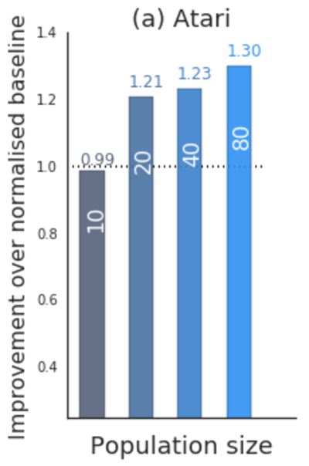
HYPERPARAMETER SELECTION
Note that PBT can underperform in the case of a low number of parallel trials (i.e. a small population size).
Population Based Training of Neural Networks

Slide 25
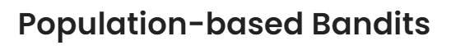
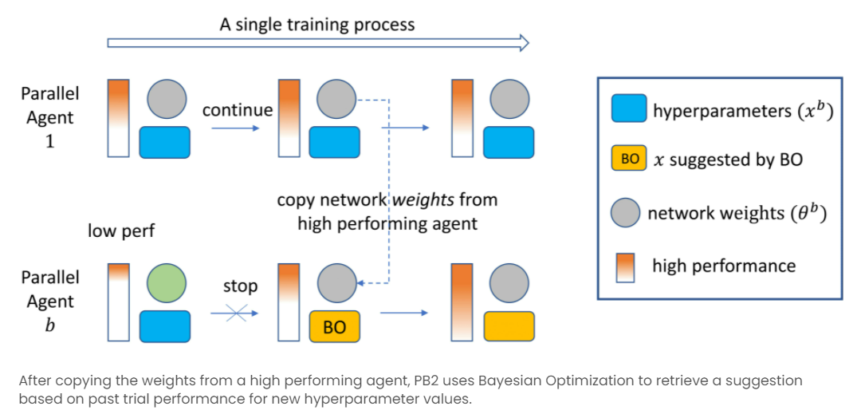
HYPERPARAMETER SELECTION
In such a case (which will happen if you do not have 8+ GPUs available), using Population Based Bandits (PB2) might be better.
Instead of randomly perturbating selected previous runs, the perturbation process here relies on a Gaussian procedure.
Provably Efficient Online Hyperparameter
Optimization with Population-Based Bandits

Slide 26
HYPERPARAMETER SELECTION
If you want to know more about the underlying mechanics of this algorithm, follow this link.
Provably Efficient Online Hyperparameter
Optimization with Population-Based Bandits

Slide 27
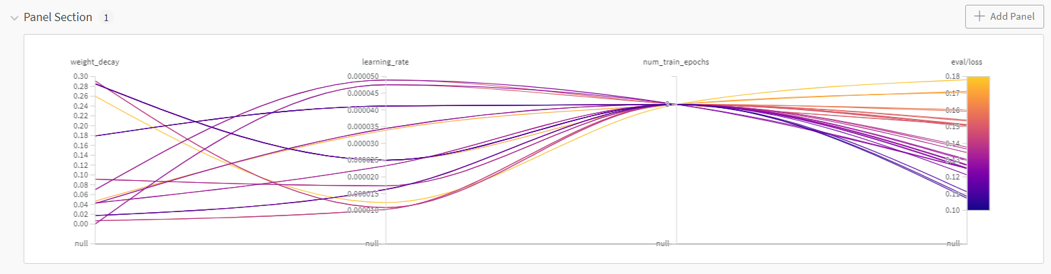
HYPERPARAMETER SELECTION
Once multiple run have been launched, it gets easier to understand how each hyperparameter affect the specific metric you are trying to measure
Hyperparameter comparison visualized using Weights & Biases interface, courtesy of Vincent Flament

Slide 28
PART I FINETUNING LANGUAGE MODELS LLMs

Slide 29
FINETUNING LLMs

Slide 30


PART III MODEL OPTIMIZATION

Slide 31
OPTIMIZING MODELS
Heavily optimizing the raw Python models that we have created involves many different steps that can be categorized as:
Reducing the size of models: distillation, head pruning, sparsity
Reducing the computation required when performing a model pass: quantization, graph optimization and compilation
Speeding up inference by optimizing hardware usage and/or dedicated software: Nvidia Triton Inference Servers, Text Generation Inference, Flash Attention, etc.

Slide 32
MODEL SIZE REDUCTION DISTILLATION

Slide 33
DISTILBERT
Philosophy
Most powerful system nowadays are really heavy, making their training complicated and fastidious. They model the human language with a great efficiency even to the smallest details.
How can we create a smaller network that would mimic the behavior of a bigger pre-trained network and focus on the major elements of the human language?

Slide 34
DISTILBERT
Philosophy
Most powerful system nowadays are really heavy, making their training complicated and fastidious. They model the human language with a great efficiency even to the smallest details.
Train a (small) student network that will learn to mimic the full output distribution of a (larger) teacher network.

Slide 35
DISTILBERT
Why would we do that?
In supervised learning, a classification model is generally trained to predict a golden class by maximizing its probability.
In many cases, a good performance model will predict an output distribution with the correct class having a high probability, leaving other classes with probabilities near zero.
But, some of these “almost-zero” probabilities are larger than the others, and this reflects, in part, the generalization capabilities of the model.

Slide 36
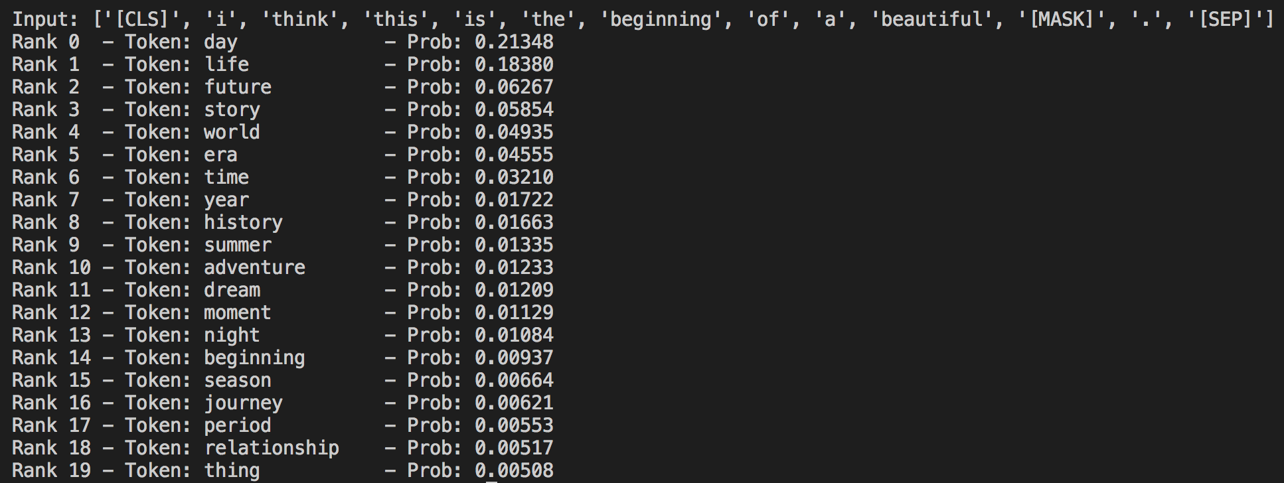
DISTILBERT
Why would we do that?
BERT results on the mask word prediction task. The goal of distillation is to lose information about all probabilities close to 0.

Slide 37
DISTILBERT
Why would we do that?
In short: distillation prevents the model to be too precise about its prediction, which results in a less computing expensive model.

Slide 38
DISTILBERT
Architecture
Same architecture as BERT, but:
Configuration dedicated to next-sentence prediction is removed
Remaining number of layers is divided by 2

Slide 39
DISTILBERT
NOTE
Logit: the vector of raw (non-normalized) predictions that a classification model generates, which is commonly then passed to a normalization function such as a softmax layer.
In other words, it is the vector values of the layer right before the softmax.

Slide 40
DISTILBERT
Behaviour
Computes cross-entropy loss over the soft targets (i.e. probabilities of the teacher) instead of the hard targets (i.e. the actual classes to be predicted)
Reminder: cross-entropy loss (or log loss) measures the performance of a classification model whose output is a probability value between 0 and 1. This kind of loss penalize predictions that are both confident and wrong.

Slide 41
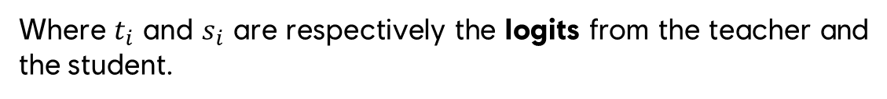

DISTILBERT
Behaviour
They standard cross-entropy loss function (without softmax) would look like the following:
$$Loss=−\sum_{i}{t_{i}×log⁡(s_{i})}$$
Where $t_{i}$ and $s_{i}$ are respectively the logits from the teacher and the student.

Slide 42
DISTILBERT
Behaviour
However, such loss isn’t sufficient. We want here to have the control over how much the learner learns from the teacher.
As a result, a softmax-temperature is introduced to control that, and is directly included in the loss function.

Slide 43
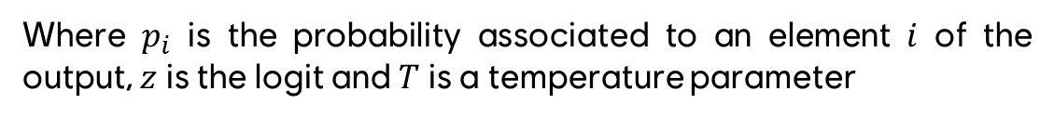

DISTILBERT
Behaviour
Here’s the formula of the softmax-temperature:
$$p_{i}= \frac{exp(\frac{z_{i}}{T})}{\sum_{j}{exp(\frac{z_{j}}{T})}}$$
Where $p_{i}$ is the probability associated to an element $i$ of the output, $z$ is the logit and $T$ is a temperature parameter

Slide 44
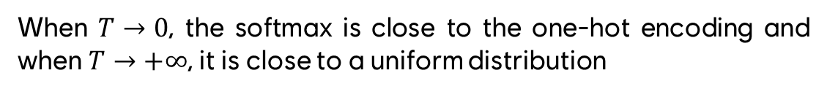
DISTILBERT
Behaviour
Here’s the formula of the softmax-temperature:
$$p_{i}= \frac{exp(\frac{z_{i}}{T})}{\sum_{j}{exp(\frac{z_{j}}{T})}}$$
When $T→0$, the softmax is close to the one-hot encoding and when $T→+∞$, it is close to a uniform distribution

Slide 45
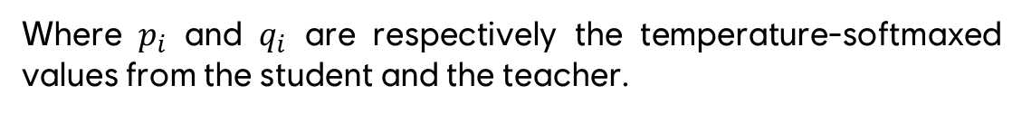

DISTILBERT
Behaviour
Hence, the loss function is refined with this softmax-temperature:
$${KL}_{Loss}= \sum_{i}{p_{i}×log\left(p_{i}\right)}−\sum_{i}{p_{i}×log\left(q_{i}\right)}$$
Where $p_{i}$ and $q_{i}$ are respectively the temperature-softmaxed values from the student and the teacher.

Slide 46
DISTILBERT
Results
Contextualized word embeddings that result from a 2 to 3 times smaller model with up to 95% similarity in terms of accuracy with the teacher model on a wide range of downstream tasks.

Slide 47
DISTILLATION – TinyBERT edition
How do we do that?
Another distillation method, introduced in the TinyBERT paper [2], highlights 3 new techniques:
Transformer distillation
Two step distillation process
Data augmentation
[2] X. Jiao et al., “TinyBERT: Distilling BERT for Natural Language Understanding,” arXiv:1909.10351 [cs], Oct. 2020. Available: http://arxiv.org/abs/1909.10351

Slide 48
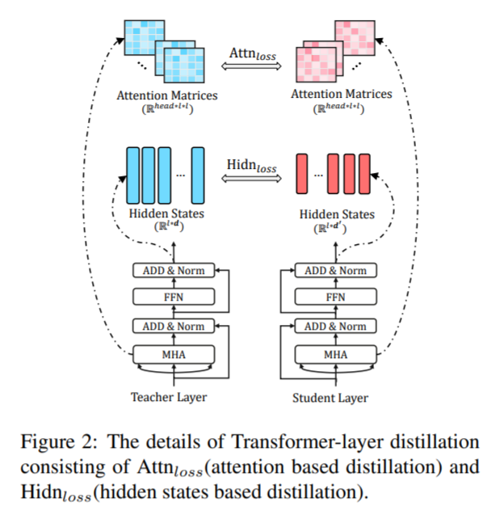
DISTILLATION – TinyBERT edition
Transformer distillation
The Transformer layer distillation introduces 3 loss functions designed to help the student mimic the teacher’s:
Embedding layer output
Attention matrices
Hidden representations (i.e. hidden states of the feed forward network in Transformer layers)
[2] X. Jiao et al., “TinyBERT: Distilling BERT for Natural Language Understanding,” arXiv:1909.10351 [cs], Oct. 2020. Available: http://arxiv.org/abs/1909.10351

Slide 49
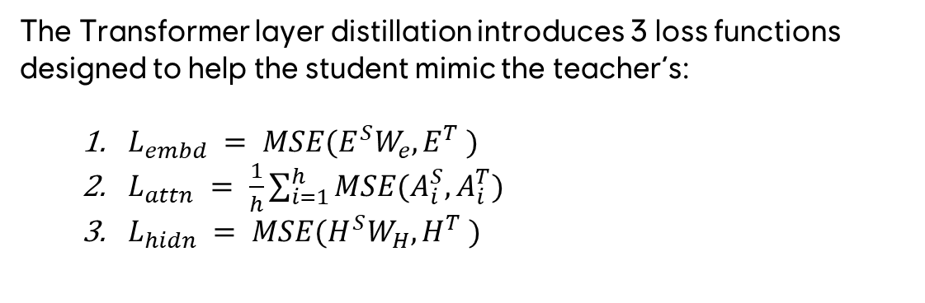
DISTILLATION – TinyBERT edition
Transformer distillation
The Transformer layer distillation introduces 3 loss functions designed to help the student mimic the teacher’s:
$L_{embd} = MSE(E^{S}W_{e}, E^{T} )$
$L_{attn} = \frac{1}{h}\sum_{i=1}^{h}{MSE(A_{i}^{S},A_{i}^{T})}$
$L_{hidn} = MSE(H^{S}W_{H}, H^{T} )$
[2] X. Jiao et al., “TinyBERT: Distilling BERT for Natural Language Understanding,” arXiv:1909.10351 [cs], Oct. 2020. Available: http://arxiv.org/abs/1909.10351

Slide 50
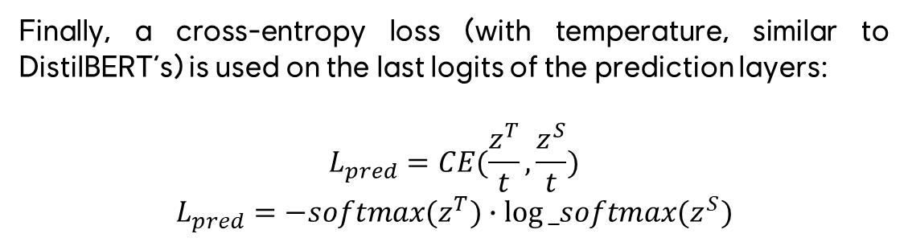
DISTILLATION – TinyBERT edition
Transformer distillation
Finally, a cross-entropy loss (with temperature, similar to DistilBERT’s) is used on the last logits of the prediction layers:
$$L_{pred}=CE(\frac{z^{T}}{t}, \frac{z^{S}}{t})$$
$$L_{pred}=−softmax(z^{T})∙log⁡_softmax(z^{S})$$
[2] X. Jiao et al., “TinyBERT: Distilling BERT for Natural Language Understanding,” arXiv:1909.10351 [cs], Oct. 2020. Available: http://arxiv.org/abs/1909.10351

Slide 51
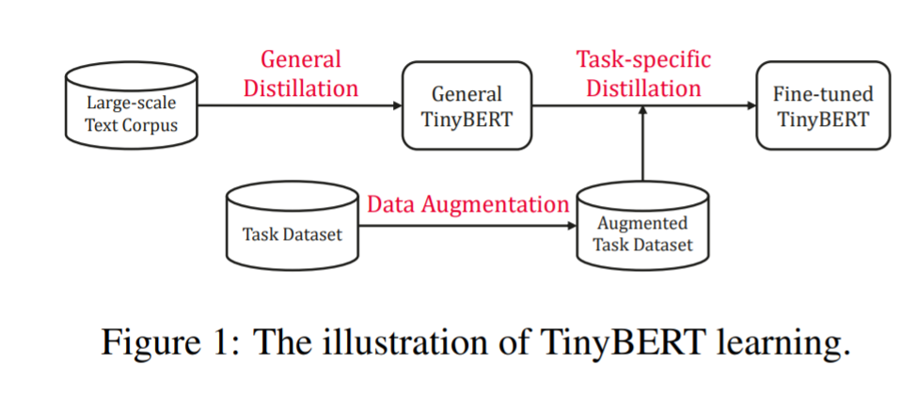
DISTILLATION – TinyBERT edition
Two step distillation process
[2] X. Jiao et al., “TinyBERT: Distilling BERT for Natural Language Understanding,” arXiv:1909.10351 [cs], Oct. 2020. Available: http://arxiv.org/abs/1909.10351

Slide 52
DISTILLATION – TinyBERT edition
Two step distillation process
General distillation
Task-specific distillation
The TinyBERT model is first trained to mimic a pre-trained, agnostic BERT model. By learning to mimic its embedding and transformer layers, a General TinyBERT is created.
Secondly, the training switches to a task-specific BERT model and continues to train the student (i.e. the General TinyBERT). Initially, the prediction layer is fixed, but it is later unfrozen for a small number of steps.
[2] X. Jiao et al., “TinyBERT: Distilling BERT for Natural Language Understanding,” arXiv:1909.10351 [cs], Oct. 2020. Available: http://arxiv.org/abs/1909.10351

Slide 53
DISTILLATION – TinyBERT edition
Data augmentation
When creating a TinyBERT model, three elements are required:
A base pretrained BERT model
A dataset corresponding to the downstream task
GloVe embeddings (any word embeddings can do the trick)
[2] X. Jiao et al., “TinyBERT: Distilling BERT for Natural Language Understanding,” arXiv:1909.10351 [cs], Oct. 2020. Available: http://arxiv.org/abs/1909.10351

Slide 54
DISTILLATION – TinyBERT edition
Data augmentation
Those GloVe embeddings are used to replace subsets of words / sentence pieces in the task-specific training set with highly probable alternatives, such as:
« Is this a car I’m seeing on the road? »
« Is this a tiny vehicle I’m seeing on the highway? »
Doing so helps the model understanding what is the actual decision process of the teacher network.
https://medium.com/dair-ai/tinybert-size-does-matter-but-how-you-train-it-can-be-more-important-a5834831fa7d

Slide 55
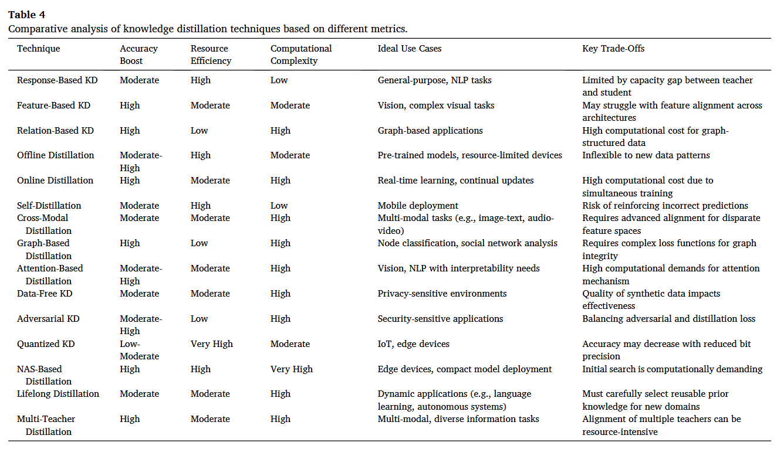
DISTILLATION TECHNIQUES
A. Moslemi, A. Briskina, Z. Dang, J. Li, A survey on knowledge distillation: Recent advancements, Machine Learning with Applications, Volume 18, 2024, 100605, ISSN 2666-8270, https://doi.org/10.1016/j.mlwa.2024.100605.

Slide 56
MODEL SIZE REDUCTION QUANTIZATION

Slide 57
QUANTIZATION
The term quantization regroup a set of techniques dedicated to reducing the precision used to represent model weights while maintaining similar performances.
Precision can be defined as the number of significant digits or bits used to represent a number. The more bits used, the more precise the representation of the number. But… A higher precision also translates in a higher memory usage.
https://huggingface.co/blog/merve/quantization

Slide 58
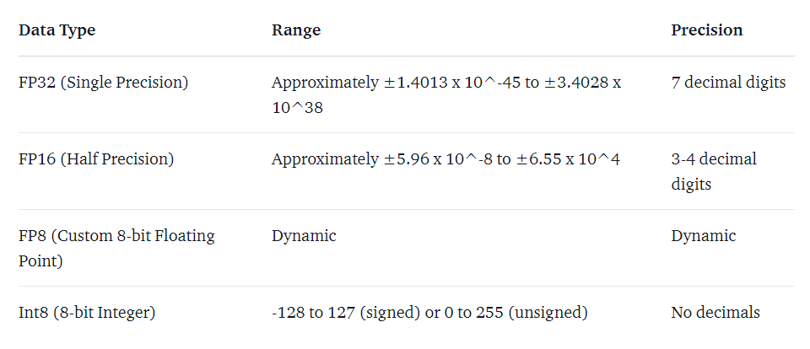
QUANTIZATION
https://huggingface.co/blog/merve/quantization

Slide 59
QUANTIZATION
The goal of quantization is to convert a model weights from a precise representation to a less precise one (e.g. fp32 → int8) while limiting the decrease in performances.
Theoretically, quantization can go down to int1 representations. Yet, performances seem to drop significantly below int8.
https://huggingface.co/blog/merve/quantization

Slide 60
QUANTIZATION TYPES
Easy to implement
Best performances
Post-training quantization (PTQ)
Quantization aware training (QAT)
Convert the weights of an already trained model to lower precision, without any retraining.
It doesn’t require any specific data and is quite fast.
Weights conversion happens during the training, which requires additional computation resources (more time, more vRAM).
It is also possible to fine-tune a quantized model to limit the degradation resulting from quantization.
https://huggingface.co/blog/merve/quantization

Slide 61
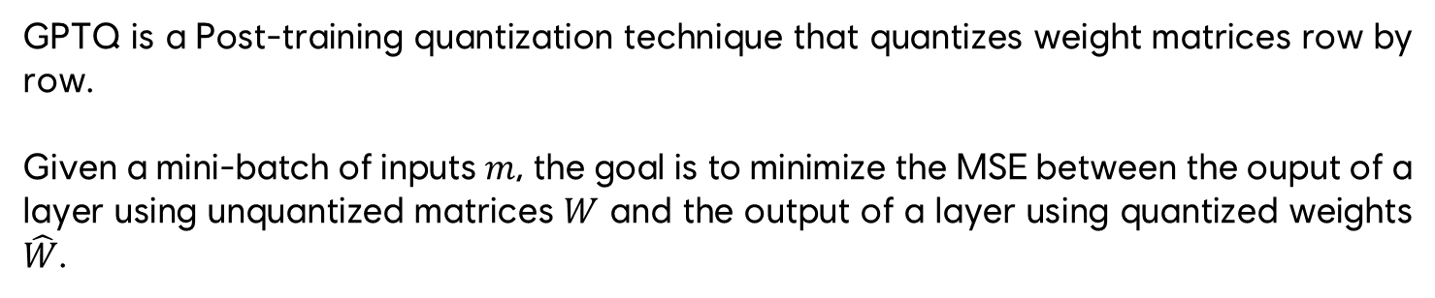
QUANTIZATION – GPTQ
GPTQ is a Post-training quantization technique that quantizes weight matrices row by row.
Given a mini-batch of inputs $m$, the goal is to minimize the MSE between the ouput of a layer using unquantized matrices $W$ and the output of a layer using quantized weights $\hat{W}$.
https://arxiv.org/pdf/2210.17323.pdf

Slide 62
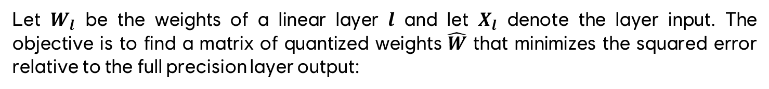
QUANTIZATION – GPTQ
Let $W_{l}$ be the weights of a linear layer $l$ and let $X_{l}$ denote the layer input. The objective is to find a matrix of quantized weights $\hat{W}$ that minimizes the squared error relative to the full precision layer output:
$${\arg{min}}_{\hat{W}} {||WX −\hat{W}X||}_{2}^{2}$$
The update of the weights relies on a closed-form formula based on Hessian matrices (square matrices of second-order derivatives describing how the gradient of a function changes with respect to each of its input variables).
https://arxiv.org/pdf/2210.17323.pdf

Slide 63
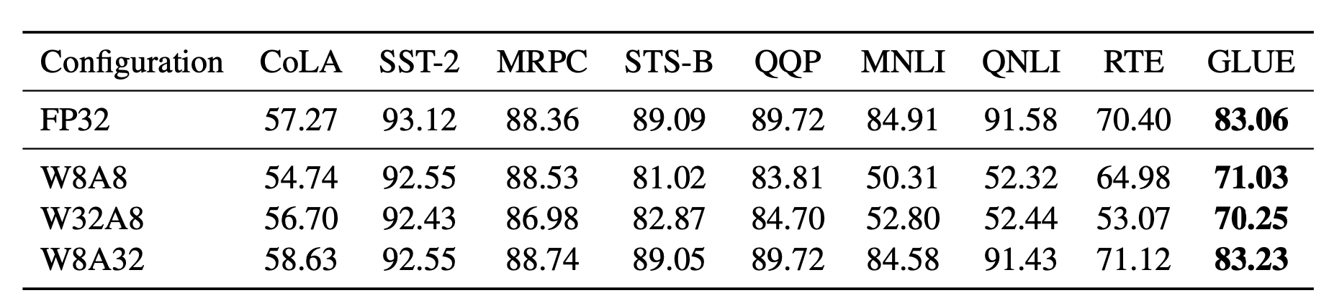
QUANTIZATION – BITSANDBYTES
Only quantizing model weights to 8-bit while keeping activation at full precision (`W8A32`) achieves much better results than any other scenario, including weights in lower precision (`W8A8` and `W32A8`). (Bondarenko et al. 2021)
https://lilianweng.github.io/posts/2023-01-10-inference-optimization/

Slide 64
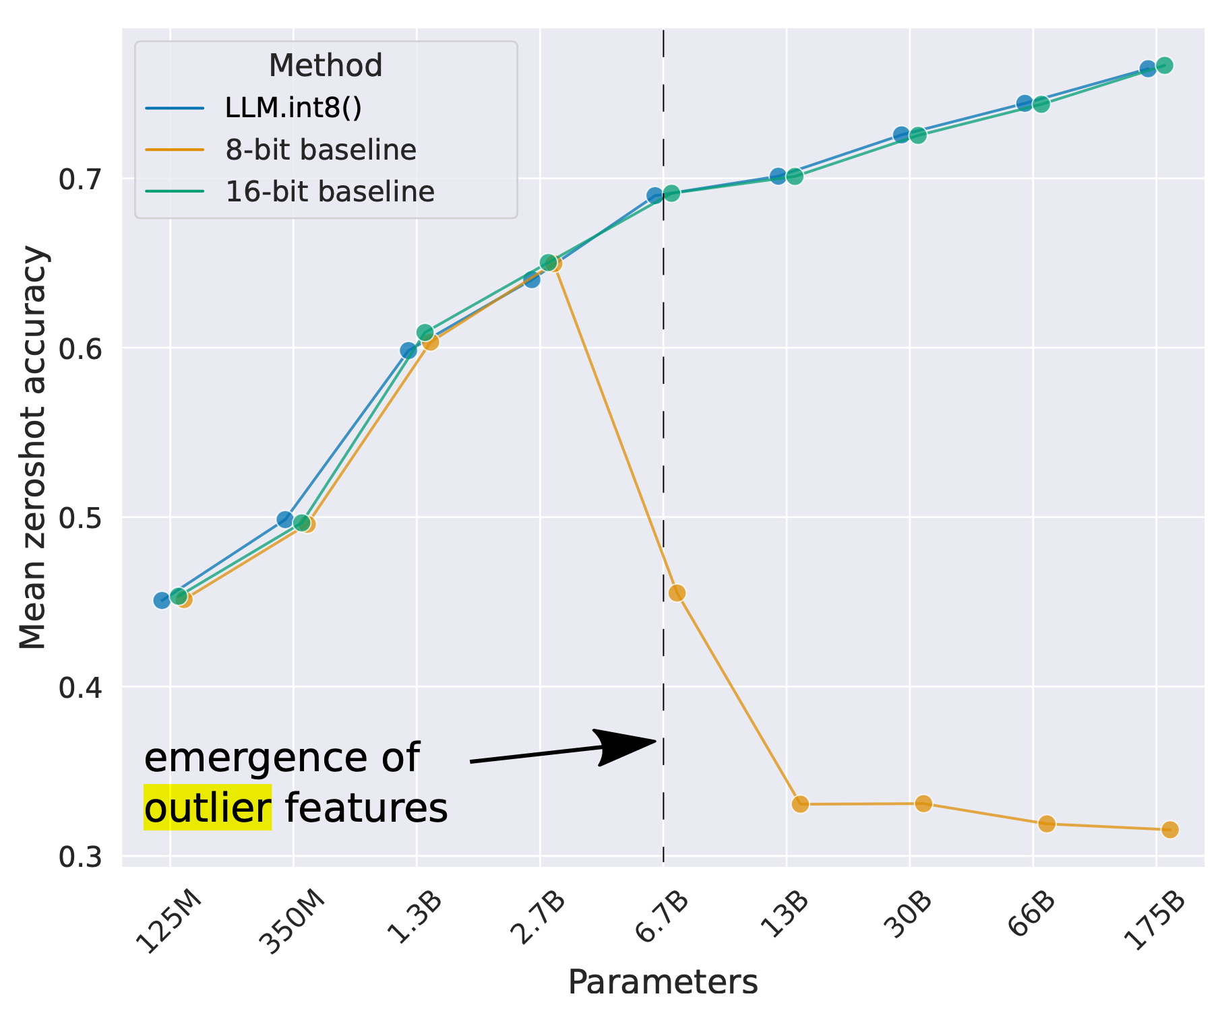
QUANTIZATION – BITSANDBYTES
For smaller sized models, regular 8bit quantization (with no input batch) leads to similar performances compared to the fp16 models.
Yet, for bigger models, such approach tend to fail due to the highly dynamic range of layer outputs.
Specifically, the activation functions tend to create outliers in terms of magnitude (especially with ReLu-like functions).
Bigger models are way more likely to have outlier values, hence bad performances
➔ Mixed precision quantization comes into play: outliers can be kept in FP16 while regular values are in INTX.
https://lilianweng.github.io/posts/2023-01-10-inference-optimization/

Slide 65
QUANTIZATION – BITSANDBYTES
Bitsandbytes (LLM.int8) can be used on any model, at runtime:
Extract the larger values (outliers) columnwise from the input hidden states
Perform the matrix multiplication of the outliers in FP16 and the non-outliers in INT8
Scale-up the non-outlier results to pull the values back to FP16, and add them to outlier results in FP16
https://lilianweng.github.io/posts/2023-01-10-inference-optimization/

Slide 66
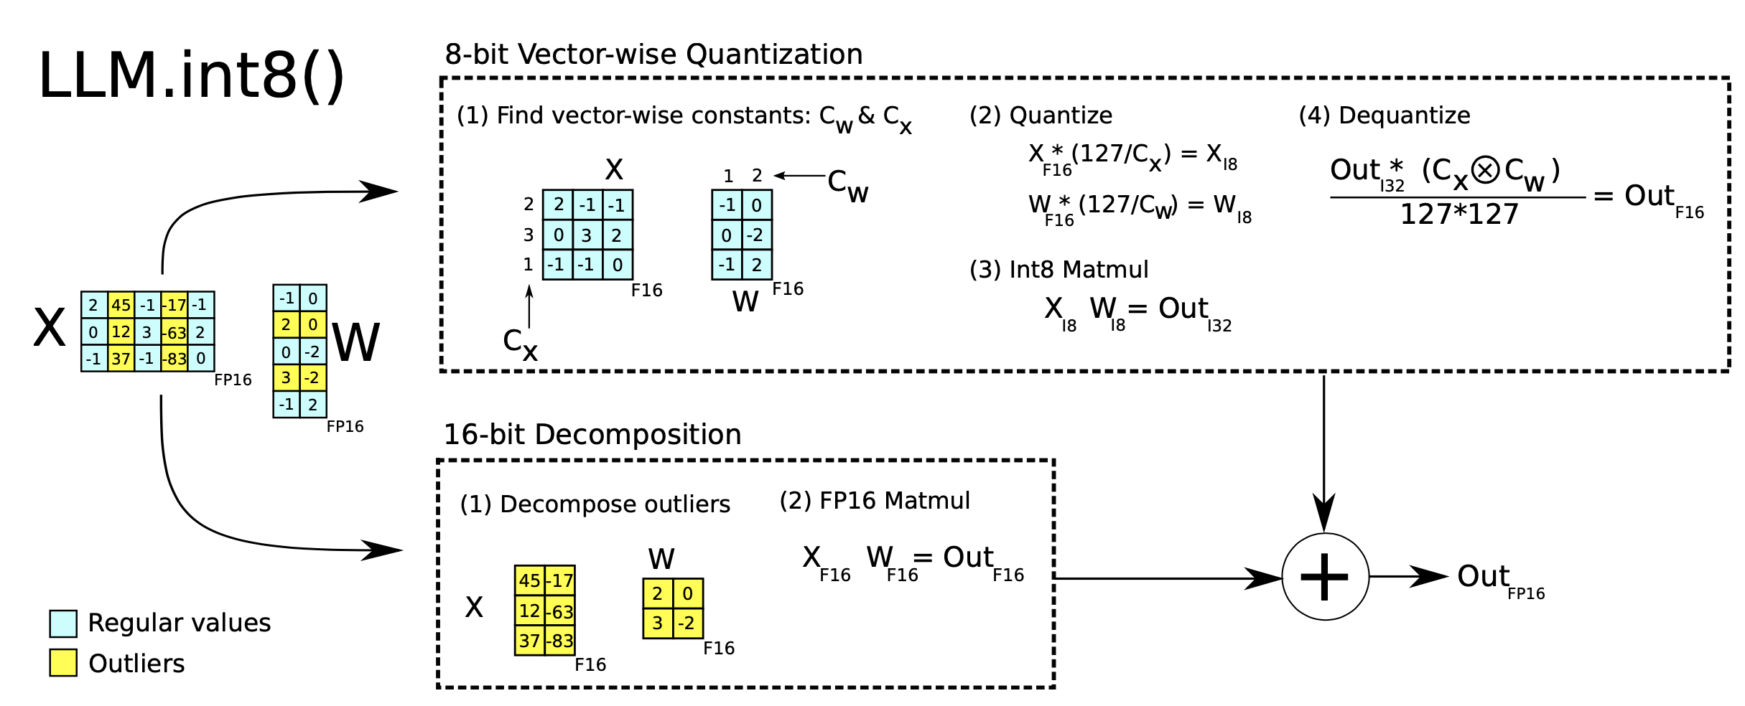
QUANTIZATION – BITSANDBYTES
https://lilianweng.github.io/posts/2023-01-10-inference-optimization/

Slide 67
SIDE NOTE - QUANTIZATION
Does representing number with a lower precision (aka less bits) increase or decrease the latency?
https://huggingface.co/blog/merve/quantization

Slide 68
SIDE NOTE - QUANTIZATION
It depends : GPU kernels are optimized for fp16/32 operations, but not always for intX computation (e.g. int4 x fp16). It is quite dependent on your GPU architecture.
Still, quantization will always yield a model with a smaller memory footprint, allowing you to load them on consumer grade (cheaper) GPUs.
https://huggingface.co/blog/merve/quantization

Slide 69
MODEL SIZE REDUCTION PRUNING

Slide 70

PRUNING ATTENTION HEADS
http://jalammar.github.io/illustrated-transformer/

Slide 71
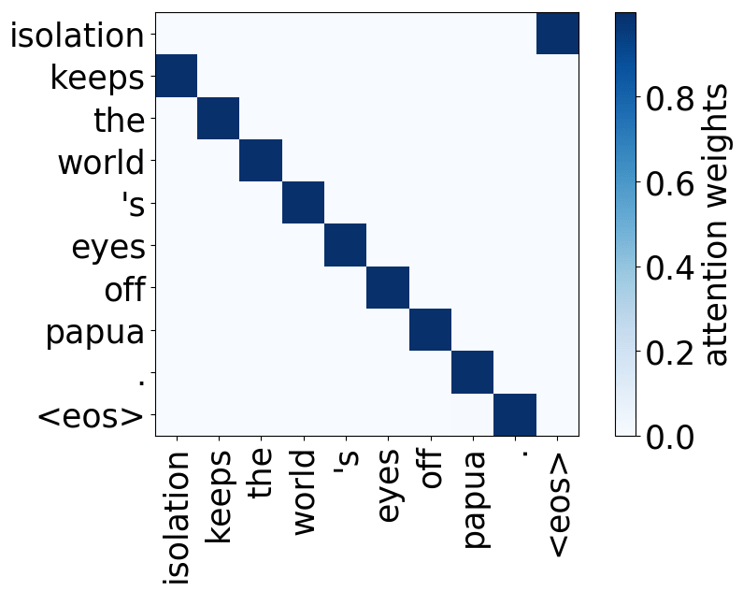
PRUNING ATTENTION HEADS
Research initiatives using a variant of Layerwise Relevance Propagation (LRP) have shown that attention heads can play consistent and interpretable roles within the model. As such, attention heads can be:
Positional heads
We refer to a head as “positional” if at least 90% of the time its maximum attention weight is assigned to a specific relative position (in practice either -1 or +1, i.e. attention to adjacent tokens).
https://lena-voita.github.io/posts/acl19_heads.html

Slide 72
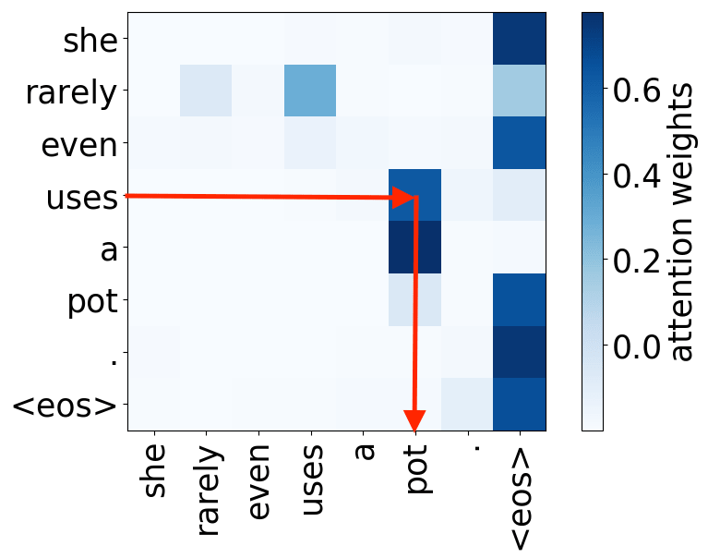
PRUNING ATTENTION HEADS
Research initiatives using a variant of Layerwise Relevance Propagation (LRP) have shown that attention heads can play consistent and interpretable roles within the model. As such, attention heads can be:
Syntactic heads
It is hypothesized that, when used to perform translation, the Transformer’s encoder may be responsible for disambiguating the syntactic structure of the source sentence. Some heads seem to attend to tokens corresponding to any of the major syntactic relations in a sentence.
https://lena-voita.github.io/posts/acl19_heads.html

Slide 73
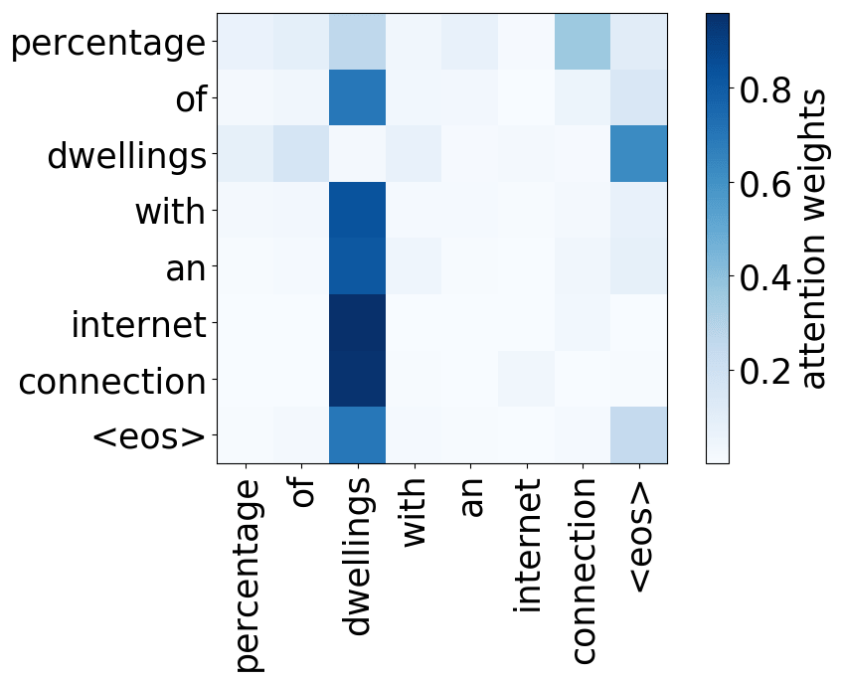
PRUNING ATTENTION HEADS
Research initiatives using a variant of Layerwise Relevance Propagation (LRP) have shown that attention heads can play consistent and interpretable roles within the model. As such, attention heads can be:
Rare token heads
For all models, we find at least a head pointing to the least frequent tokens in a sentence.
Such heads seem to help focusing on rare words even though they aren’t seen often and might help in correctly modeling them.
https://lena-voita.github.io/posts/acl19_heads.html

Slide 74
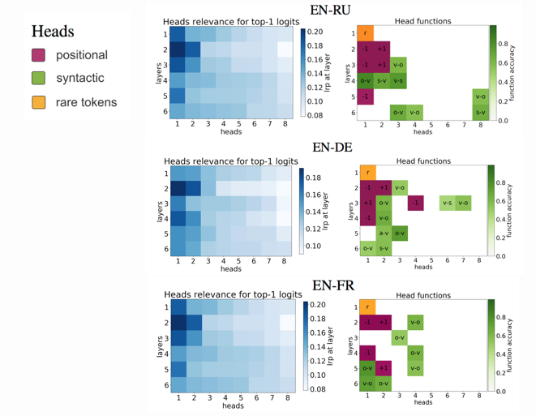
PRUNING ATTENTION HEADS
Some heads in some layers showcase those strong roles, however many other aren’t easily interpretable.
As such, it raises the following question: are all heads heavily contributing to the model accuracy?
https://lena-voita.github.io/posts/acl19_heads.html

Slide 75
ONLY ATTENTION HEADS?
Can we only prune attention heads? No, technically, all weights and connections in a network can be pruned.
The basic steps are the following:
Train a model until it reaches good performances (aka smallest loss possible)
Prune all parameters based on a specific pruning procedure (magnitude pruning, Layer-wise Relevance Propagation, etc.)
(Optional) Retrain the model using only remaining parameters to recover for the lost performances
https://lilianweng.github.io/posts/2023-01-10-inference-optimization/#sparsity

Slide 76
MAGNITUDE PRUNING
Magnitude-based weight pruning uses the magnitude of each weight as a proxy for its importance to the model quality, and removes the least important weights according to some sparsification schedule.
https://arxiv.org/pdf/1902.09574.pdf

Slide 77
COMPUTATION OPTIMIZATION GRAPH OPTIMIZATION

Slide 78
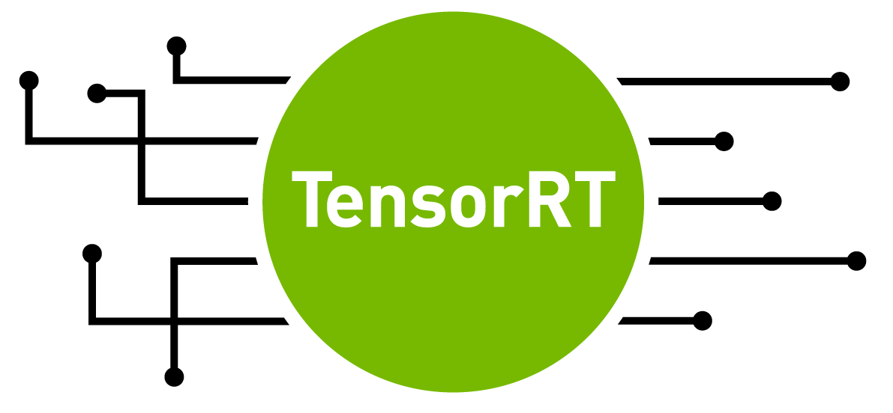

GRAPH OPTIMIZATION
By definition, model execution in PyTorch or Tensorflow is based on imperative code, a programming paradigm describing a sequence of steps that will change a program (or object) state.
To perform static analysis and find patterns to optimize, it is necessary to first convert the models into (almost) static graphs.

Slide 79
GRAPH OPTIMIZATION
Converting a model to a static graph can be done in two ways:
Tracing
Send some dummy data to the model and let a tool trace the operations done inside the model to build a graph out of it.
Doesn’t handle all the computation types possible
Scripting
Rewriting the model backbone in a certain way to maintain the potentially dynamic logic of the model execution
Is harder to implement

Slide 80
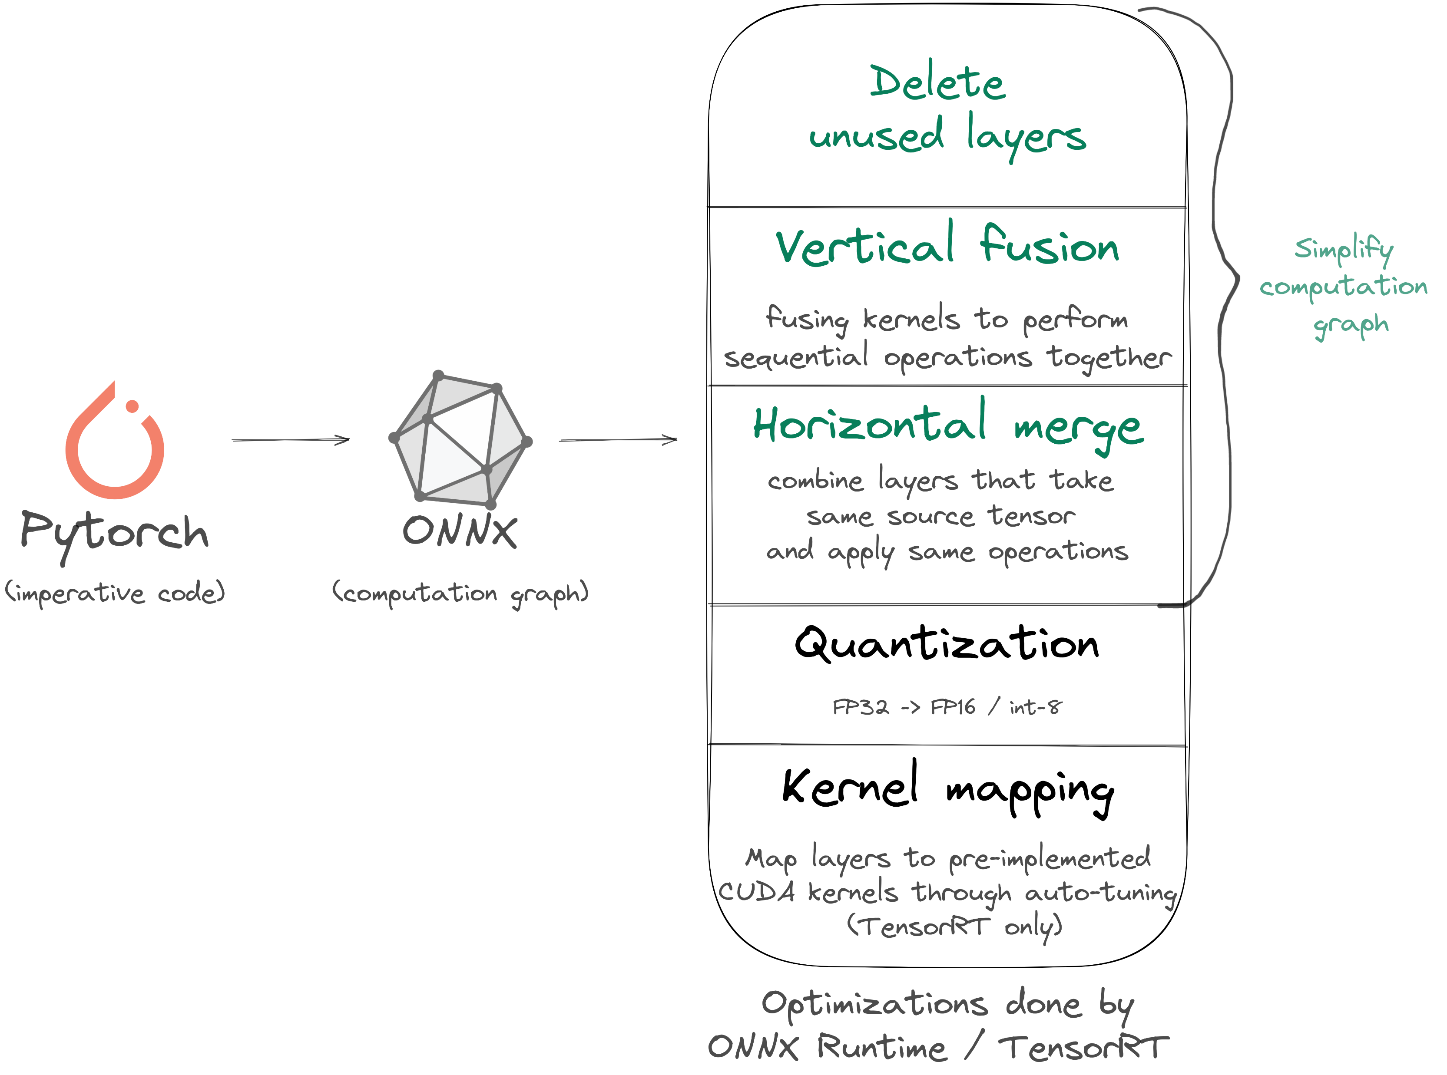
GRAPH OPTIMIZATION
https://els-rd.github.io/transformer-deploy/onnx_convert/

Slide 81
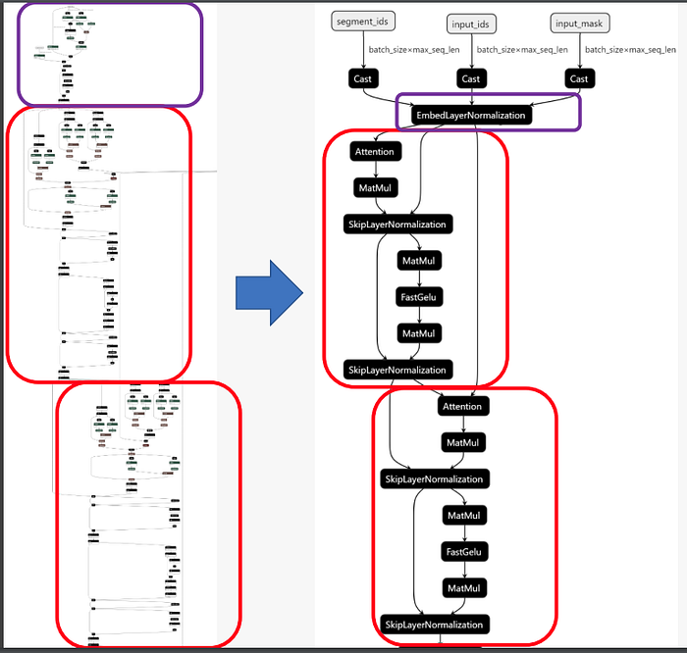
GRAPH OPTIMIZATION

Slide 82
PART IV MODEL DEPLOYMENT

Slide 83
DEPLOYMENT TYPES
Batch (offline) serving
Real-time serving
Designate ML models that generate predictions on a periodic, infrequent basis. They are generally called in automated pipelines.
Example use case: D-1 user review processing to get a grasp of user sentiment.
Designate ML models that can be called at any time and must answer quickly. This is generally done through an API.
Example use case: live moderation

Slide 84
BATCH (OFFLINE) SERVING

Slide 85
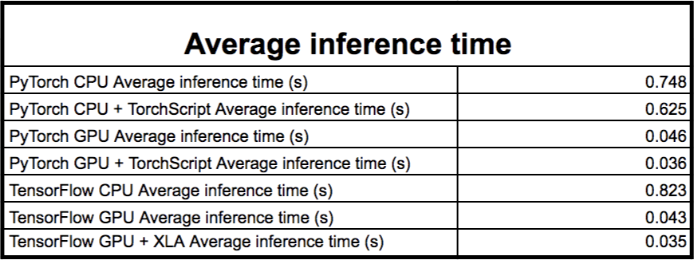







BATCH (OFFLINE) SERVING
Estimated time for 1M texts
$$\sim 8,6 days$$
$$\sim 7,2 days$$
$$\sim 12,7 hours$$
$$\sim 10 hours$$
$$\sim 9,5 days$$
$$\sim 10,4 hours$$
$$\sim 9,4 hours$$
Average inference time of RoBERTa model over various batch sizes and sequence lengths. The gains obtained from using a GPU over a CPU is illustrated here (x16 in speed) Blogpost and detailed results: https://medium.com/huggingface/benchmarking-transformers-pytorch-and-tensorflow-e2917fb891c2

Slide 86
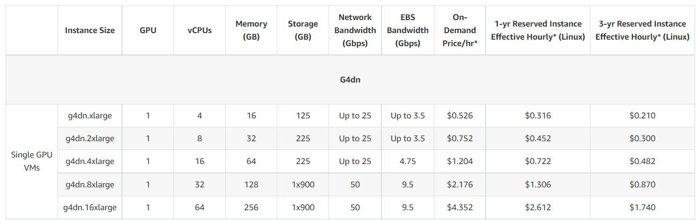
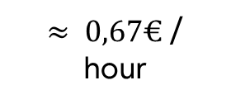
BATCH (OFFLINE) SERVING
Amazon Web Services EC2 G4 Pricing
(instances dedicated to ML inference with Tesla V4 GPUs)
$≈ 0,67€$/ hour
https://aws.amazon.com/ec2/instance-types/g4/

Slide 87
REAL-TIME SERVING

Slide 88
REAL-TIME SERVING
Up to this point, showcased model were created using Python with either Pytorch or Tensorflow backends.
Since they are heavy architectures, it makes sense to serve them through a containerized API so that (a) only one infrastructure has to be deployed and (b) its usage does not interfere with any other process on the same system.
The most basic way to do so is to serve our Transformers model through FastAPI using either the transformers library or raw Pytorch / Tensorflow.

Slide 89
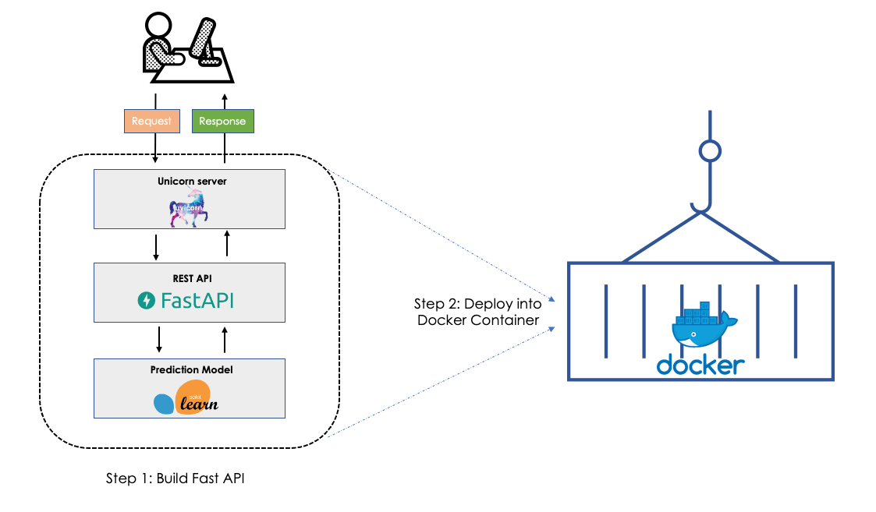
REAL-TIME SERVING
https://towardsdatascience.com/step-by-step-approach-to-build-your-machine-learning-api-using-fast-api-21bd32f2bbdb

Slide 90
KEY CONSIDERATIONS (REAL TIME)
Latency
Time taken to process a user request
Throughput
Number of requests that can be handled by the model in 1 second
(v)RAM
Quantity of RAM available on the computer / GPU, in which models and user inputs will be stored
Provisioning needs
How much parallel systems and replica are needed for the requests load / call pattern

Slide 91

LATENCY AND RPS OPTIMIZATION
https://wiki.lfaidata.foundation/download/attachments/22249690/2.3%202020_Apr_ONNX%20MEETUP_ORT%20breakthrough%20optimizations%20for%20transformer%20inference%20on%20GPU%20and%20CPU.pdf?version=1&modificationDate=1586564917000&api=v2

Slide 92

(v)RAM
As a rule of thumb, multiply the number of params by two to get the RAM requirement of a model (float16):
https://huggingface.co/blog/optimize-llm

Slide 93
INFERENCE ENGINES

Slide 94


LANGUAGE MODELS

Slide 95

LARGE LANGUAGE MODELS
Model sharding
Quantization support
Tensor parallelism
Response streaming
Flash Attention support
Telemetry included
Batching support
https://github.com/huggingface/text-generation-inference

Slide 96


LARGE LANGUAGE MODELS
Model sharding
Quantization support
Tensor parallelism
Response streaming
Optimized CUDA kernels
Flash Attention + PagedAttention
Telemetry included
https://vllm.ai/

Slide 97
LATENCY OF LLMs

Slide 98

TIME TO FIRST TOKEN (TTFT)
When an input is processed by an LLM, generating the first output token requires computing attention across all tokens in the prompt.
This initial delay, known as Time to First Token (TTFT), scales directly with the length of the input: the longer the prompt, the higher the TTFT.

Slide 99
TIME PER OUTPUT TOKEN (TPOT)
After the initial forward pass, generating the next token only requires computing attention between the newly generated token and the cached key and value vectors from previous tokens.
This reuse of past attention states is known as the KV cache.

Slide 100
TIME PER OUTPUT TOKEN (TPOT)
Time Per Output Token (TPOT), also known as Inter-Token Latency, represents the average time the model takes to generate each token in the output sequence.

Slide 101
END TO END LATENCY
End-to-end latency refers to the total time from when the LLM begins processing an input prompt to when it generates the end-of-speech token. It can be estimated using the following formula:

Slide 102

THANK YOU!
Pictures credit: Ismail Inceoglu

